Slide 1
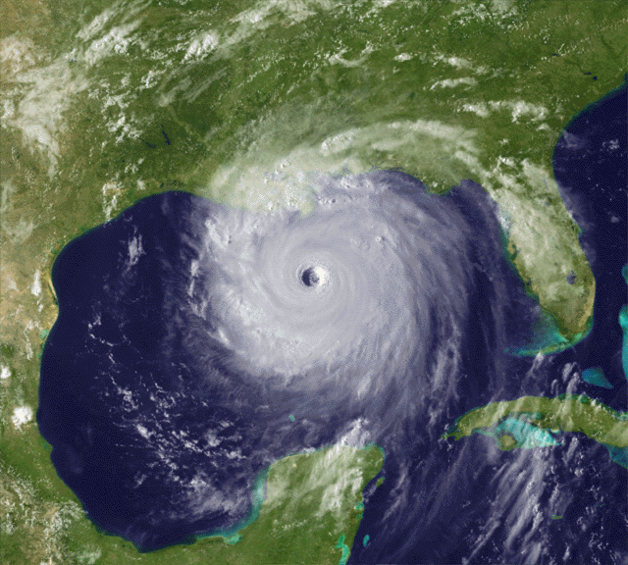
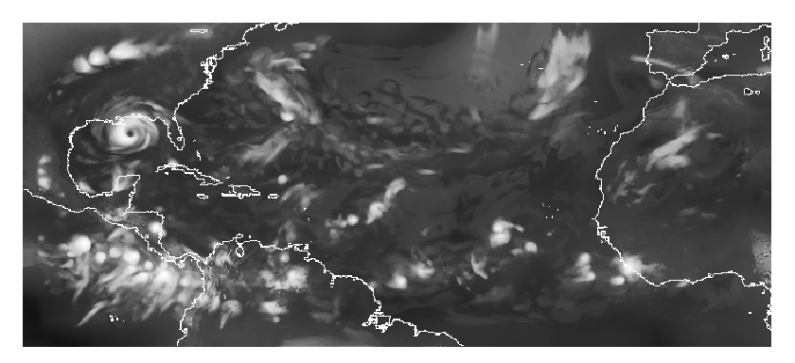
Atlantic Hurricanes and Climate Change
1
Hurricane Katrina, Aug. 2005
Tom Knutson
Geophysical Fluid Dynamics Lab/NOAA
Princeton, New Jersey
http://www.gfdl.noaa.gov/~tk
GFDL Collaborators:
Joe Sirutis
Isaac Held
Gabe Vecchi
Bob Tuleya
Morris Bender
Steve Garner
Ming Zhao
S.-J. Lin
GFDL model simulation of Atlantic hurricane activity
Notes:
1

Slide 2
Talk Outline
What is the issue?
Analysis of Observations
Modeling Studies
Remaining Issues…or could we be wrong?

Slide 3
Tropical Cyclones and Climate Change: An Assessment
WMO Expert Team on Climate Change Impacts on Tropical Cyclones
February 2010
World Meteorological Organization
Weather Research Programme
Working Group on Tropical Meteorology Research

Slide 4
Expert Team Members:
John McBride, Co-Chair Center for Australian Weather and Climate Research,
Melbourne, Australia
Tom Knutson, Co-Chair Geophysical Fluid Dynamics Laboratory/NOAA,
Princeton, USA
Johnny Chan University of Hong Kong, Hong Kong, China
Kerry Emanuel Massachusetts Institute of Technology, Cambridge, USA
Greg Holland National Center for Atmospheric Research, Boulder, USA
Chris Landsea National Hurricane Center/NOAA, Miami, USA
Isaac Held Geophysical Fluid Dynamics Laboratory/NOAA, USA
Jim Kossin National Climatic Data Center/NOAA, Madison, USA
A.K. Srivastava India Meteorological Department, Pune, India
Masato Sugi Research Institute for Global Change/JAMSTEC, Yokohama, Japan

Slide 5
SUMMARY ASSESSMENT:
Detection and Attribution:
It remains uncertain whether past changes in any tropical cyclone activity (frequency, intensity, rainfall, etc.) exceed the variability expected through natural causes, after accounting for changes over time in observing capabilities.

Slide 6
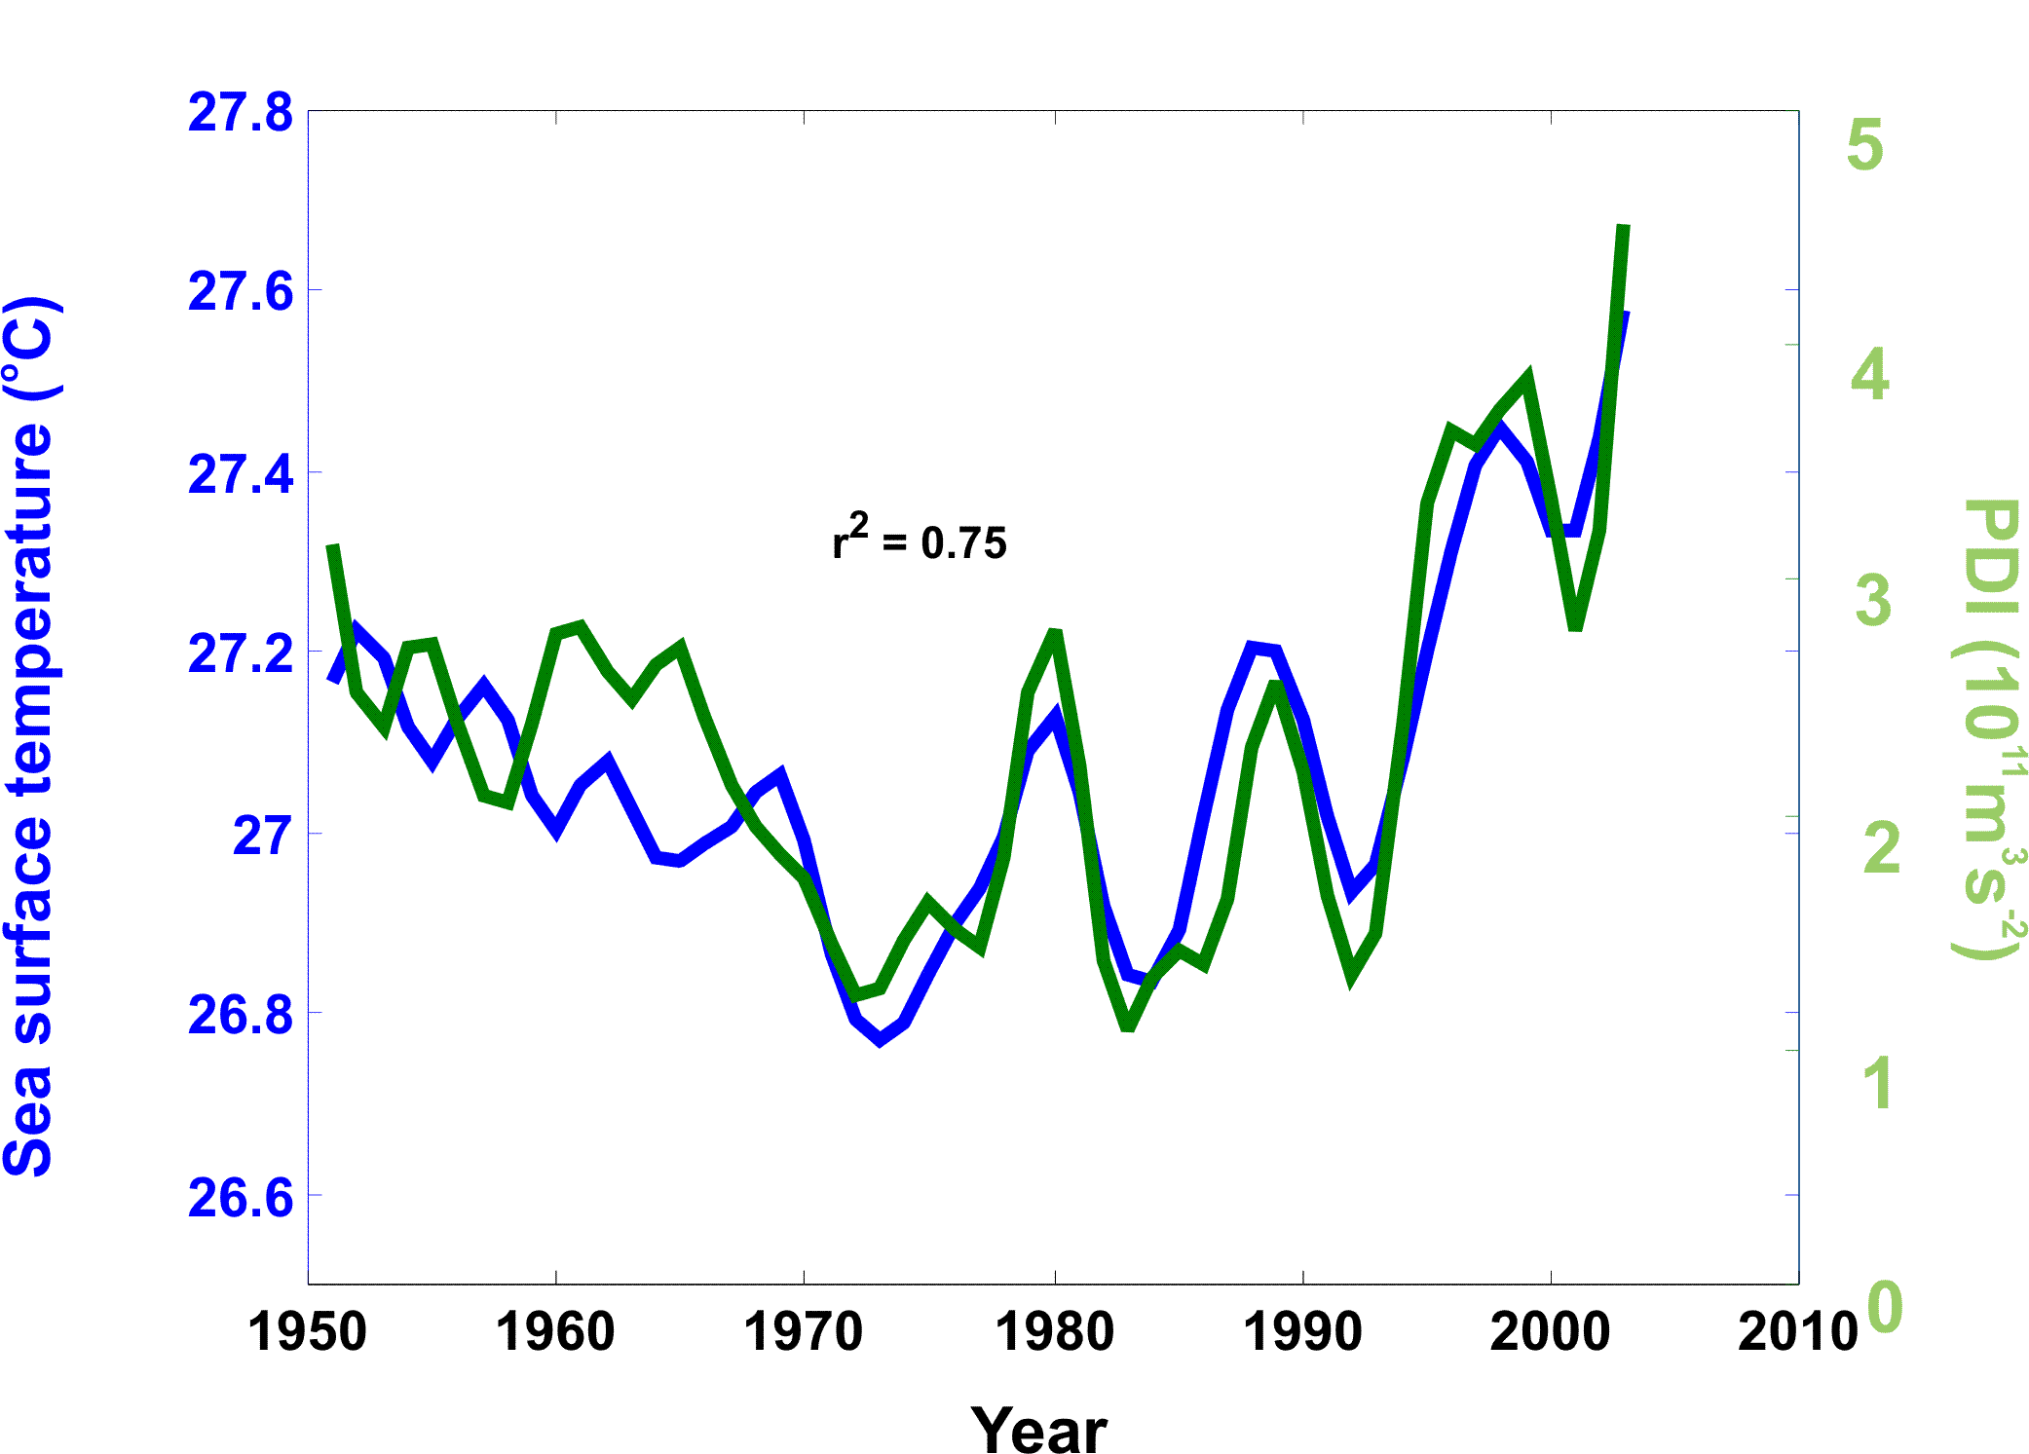
6
There is some recent evidence that overall Atlantic hurricane activity may have increased since in the 1950s and 60s in association with increasing sea surface temperatures…
Increasing data uncertainty
PDI is proportional to the time integral of the cube of the surface wind speeds accumulated across all storms over their entire life cycles.
Source: Kerry Emanuel, J. Climate (2007).
Notes:
6

Slide 7
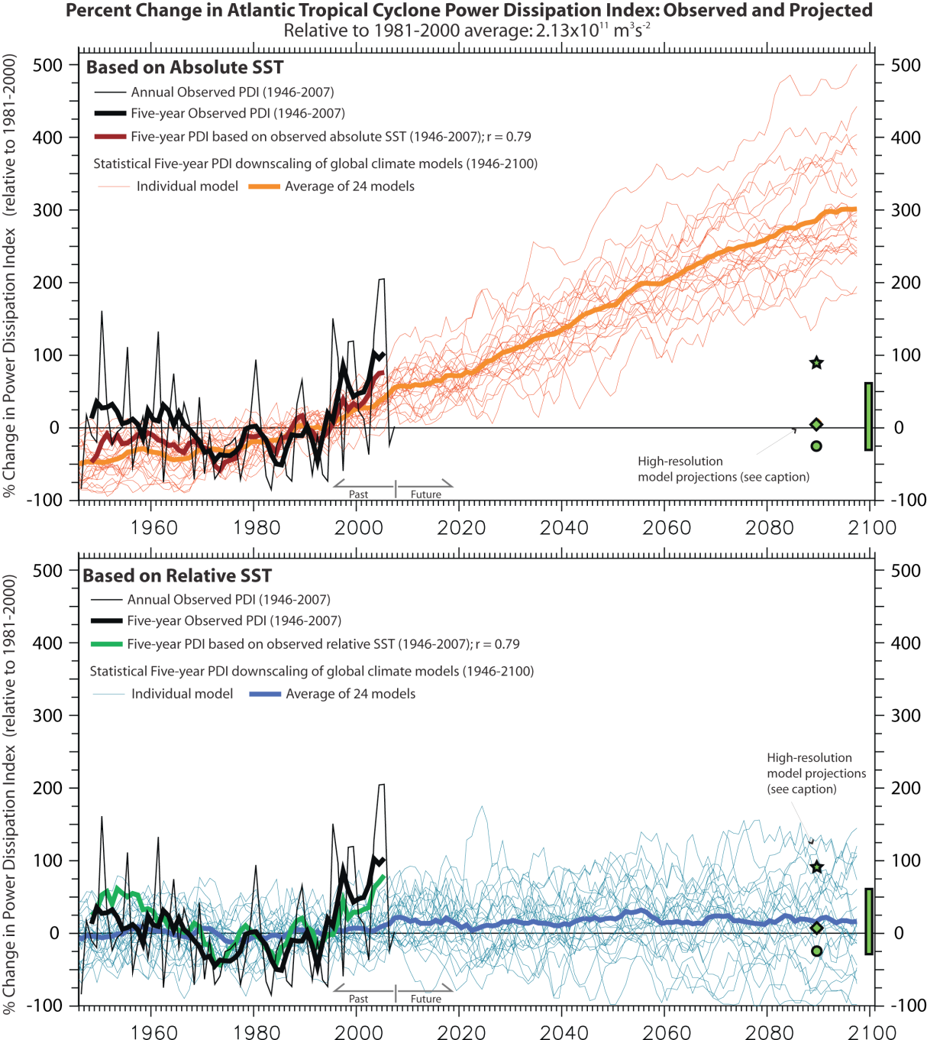
Statistical projections of 21st century Atlantic hurricane activity have a large dependence on the predictor used.
Projection 1: Absolute SST
~300% projected increase in
Power Dissipation
Indirect attribution:
CO2 → SST → Hurricanes
Projection 2: Relative SST
Projected change:
sign uncertain, +/- 80%
No Attribution
Source:
Vecchi et al. Science (2008)

Slide 8
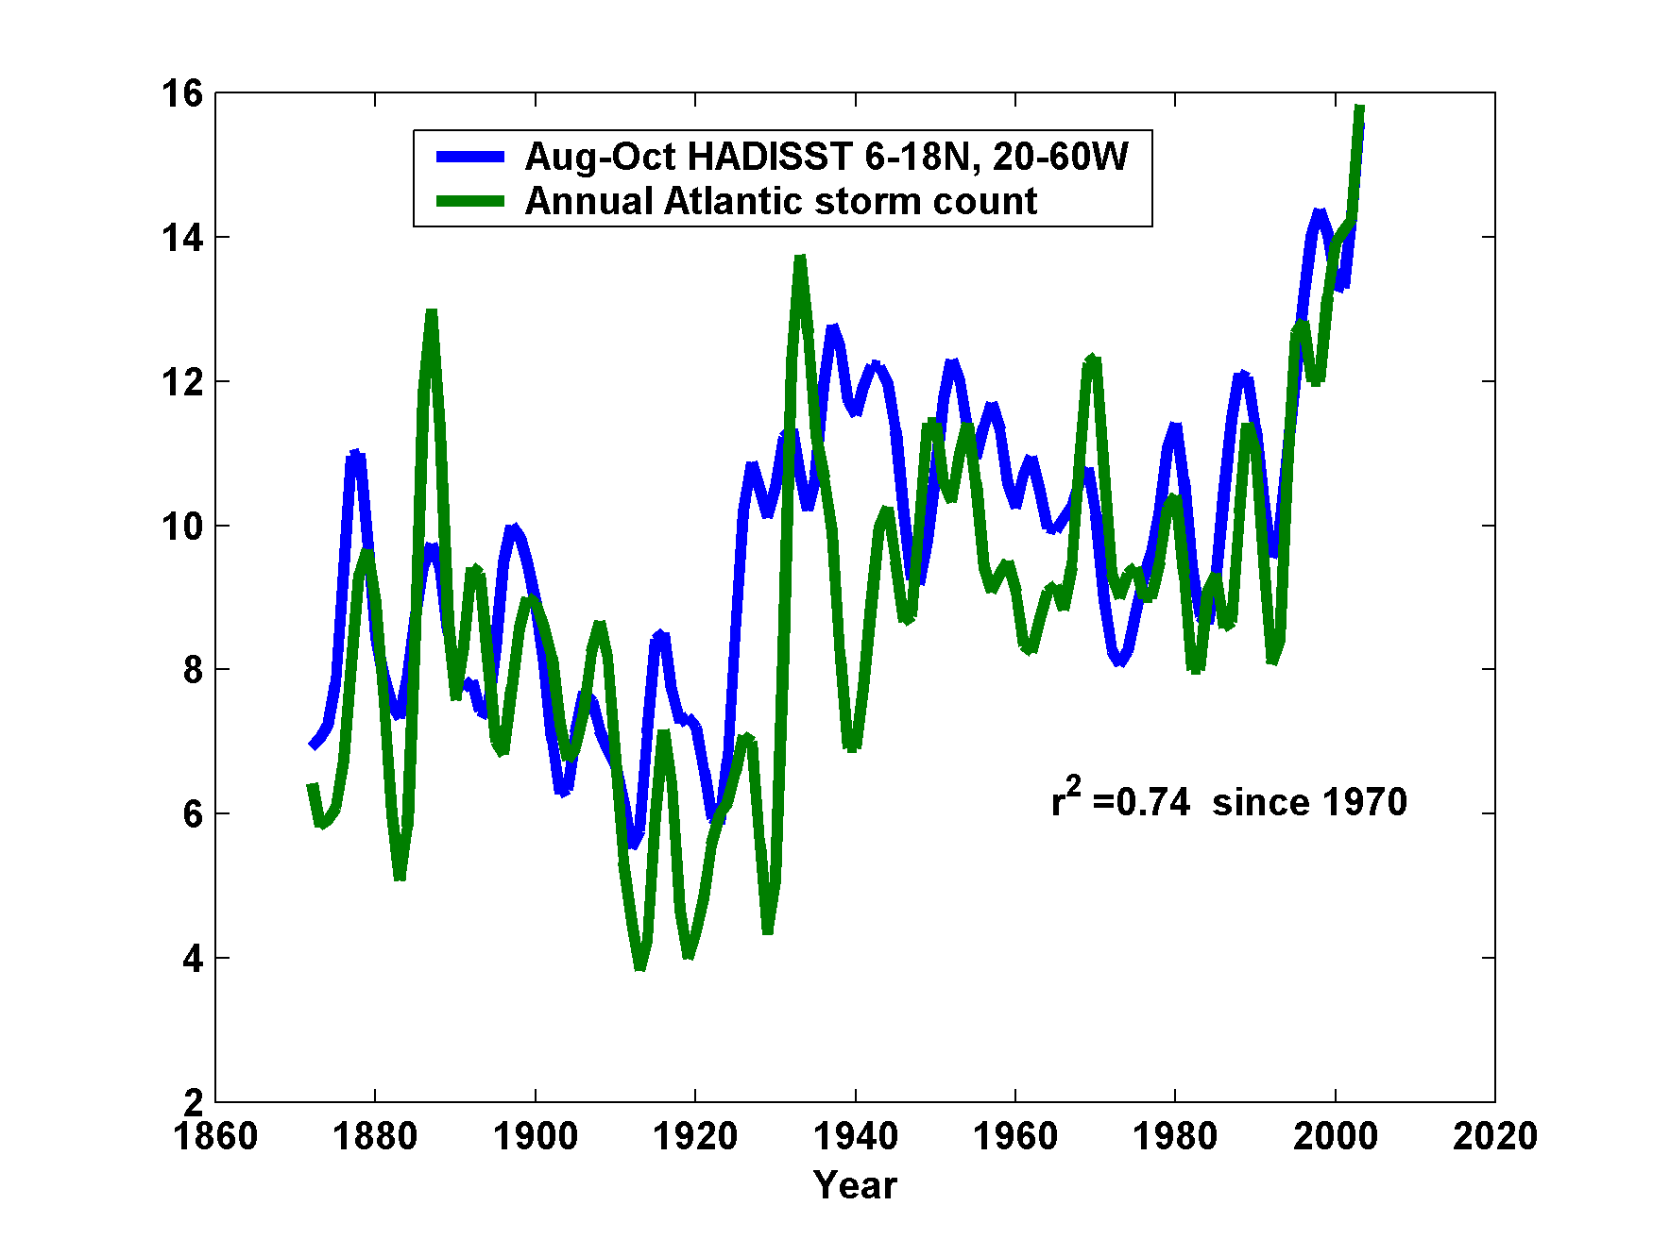
The frequency of tropical storms (low-pass filtered) in the Atlantic basin since 1870 has some correlation with tropical Atlantic SSTs
But is the storm record reliable enough for this?
Source: Emanuel (2006); Mann and Emanuel (2006) EOS. See also Holland and Webster (2007) Phil. Trans. R. Soc. A
Notes:
8

Slide 9
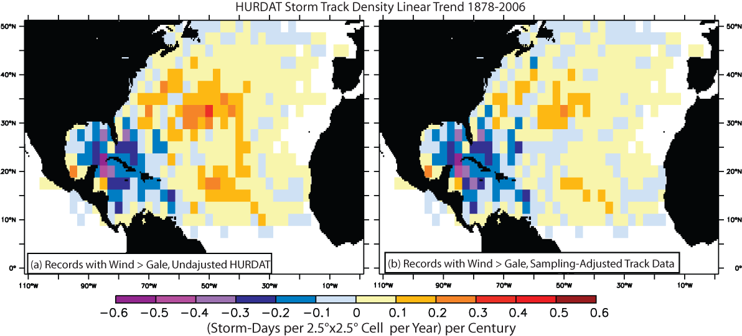
Linear trends in tropical storm track density (1878-2006): Decreases in the Gulf of Mexico and Caribbean
Increases mostly found in the open Atlantic and off the U.S. East Coast (based on original, unadjusted data)…
Source: Vecchi and Knutson, J. Climate, 2008.

Slide 10
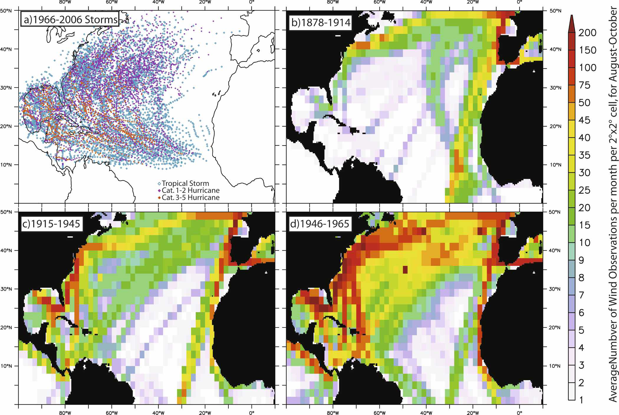
Ship tracks have changed in density and location over time
Source: Vecchi and Knutson , J. Climate, 2008.

Slide 11
Reconstructing past tropical cyclone counts
Satellite-era (1965-2006) storm tracks assumed perfect.
Apply satellite-era storm tracks to documented ship tracks (ICOADS).
Storm detected if ship within radius of tropical storm force winds (17 m/s). First detection must occur equatorward of 40N. Monte Carlo simulation, varying storm radii within reasonable bounds.
All land assumed to be “perfect detector” of tropical storms (equatorward of 40N)—planned to further test…
Assume all relevant ship tracks are in data base—plan further tests with additional tracks. (First will look for evidence of storms in “new” ship data.)

Slide 12
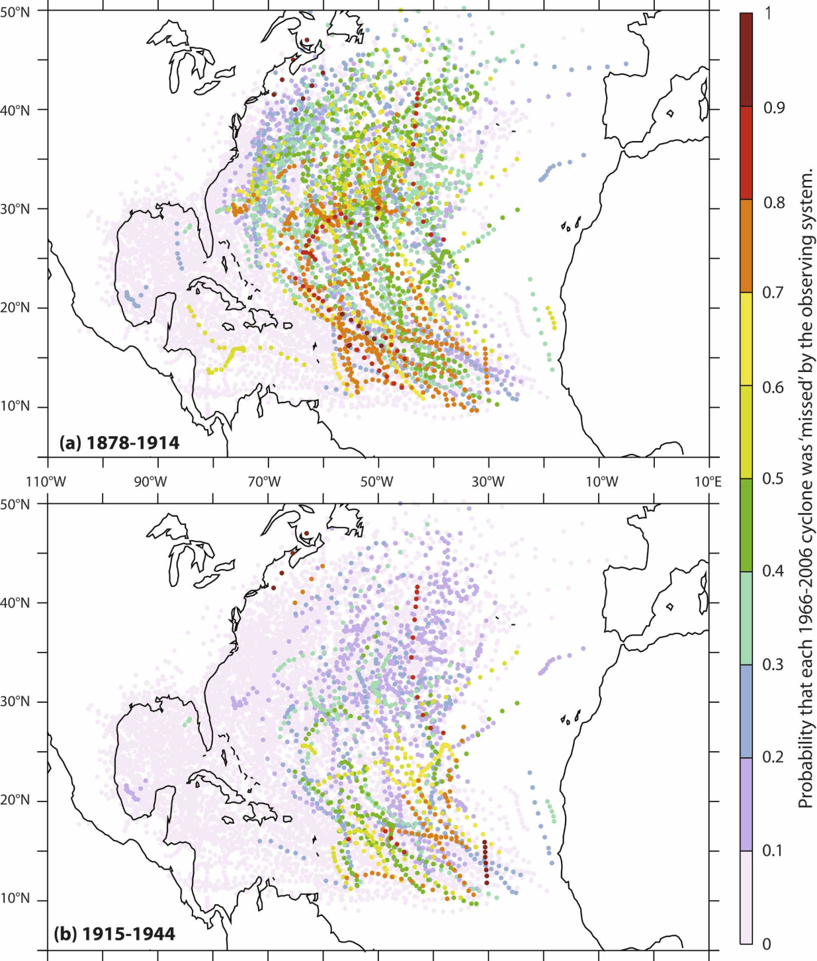
Estimated probabilities that individual cyclones (1966-2006) were ‘missed’ by the observing systems for earlier decades…
Source: Vecchi and Knutson , J. Climate, 2008.

Slide 13
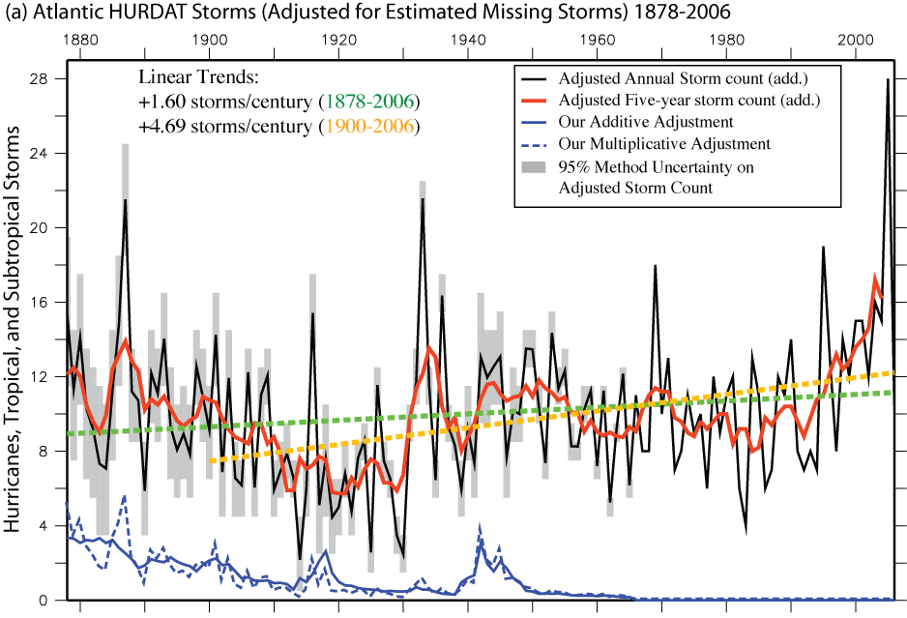
Atlantic Tropical Storm counts show no significant trend from 1878 after adjusting for ‘missing storms’ based on ship track densities.
+1.60 storms/century (1878-2006)
+4.39 storms/century (1900-2006)
1880 1900 1920 1940 1960 1980 2000
Trend from 1878-2006: Not significant (p=0.05, 2-sided tests, computed p-val ~0.2)
Trend from 1900-2006: Is significant at p=0.05 level
Source: Vecchi and Knutson, J. Climate, 2008.

Slide 14
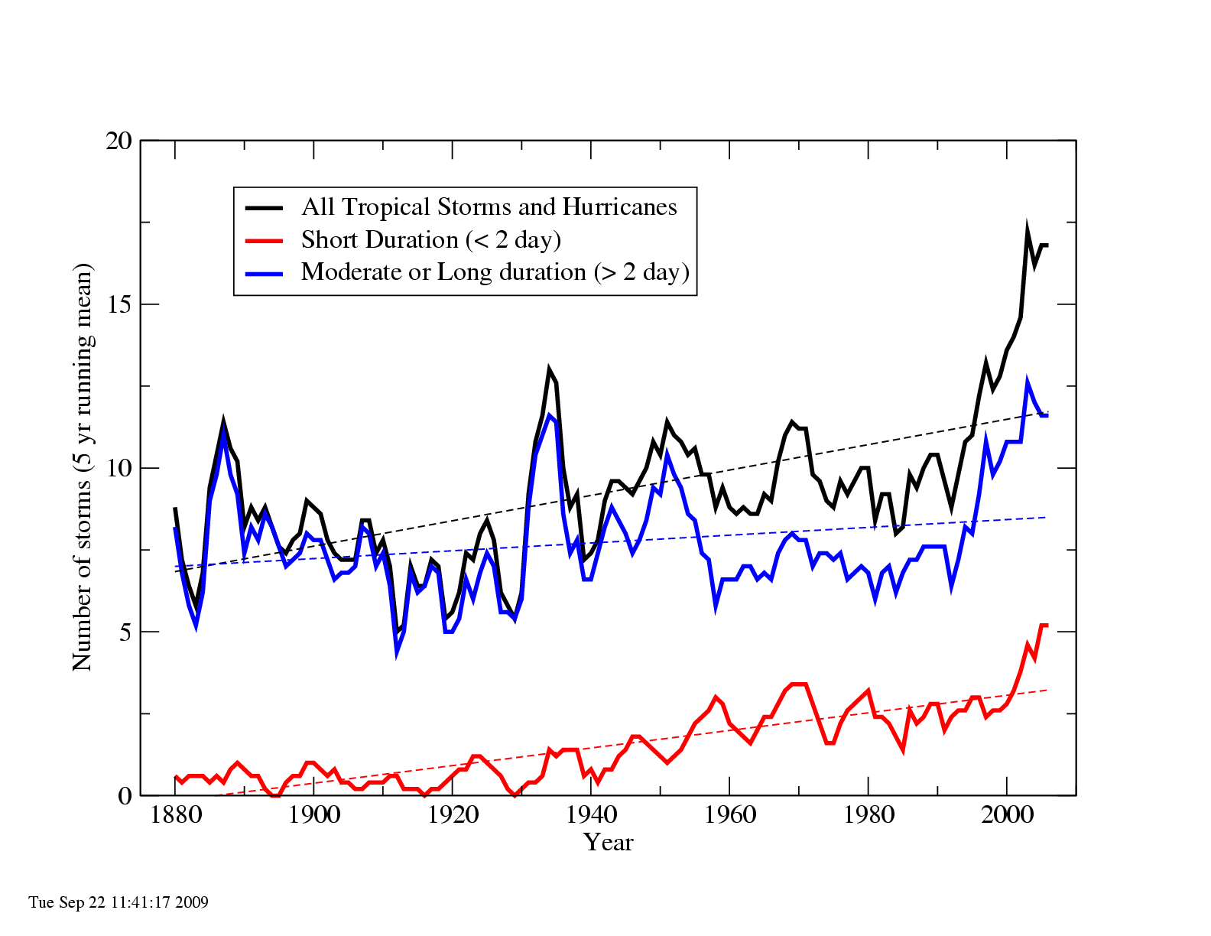
The rising trend in Atlantic tropical storms is due mostly to very short lived storms (< 2 day duration)

Slide 15
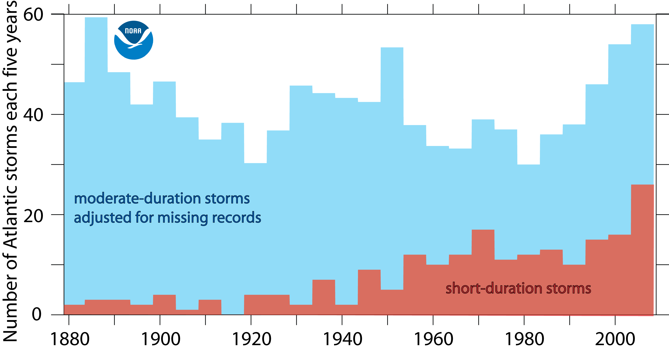
Atlantic tropical storms (< 2 day duration) show a strong rising trend, but storms of >2 day duration--adjusted for missing storms--do not show a trend.

Slide 16
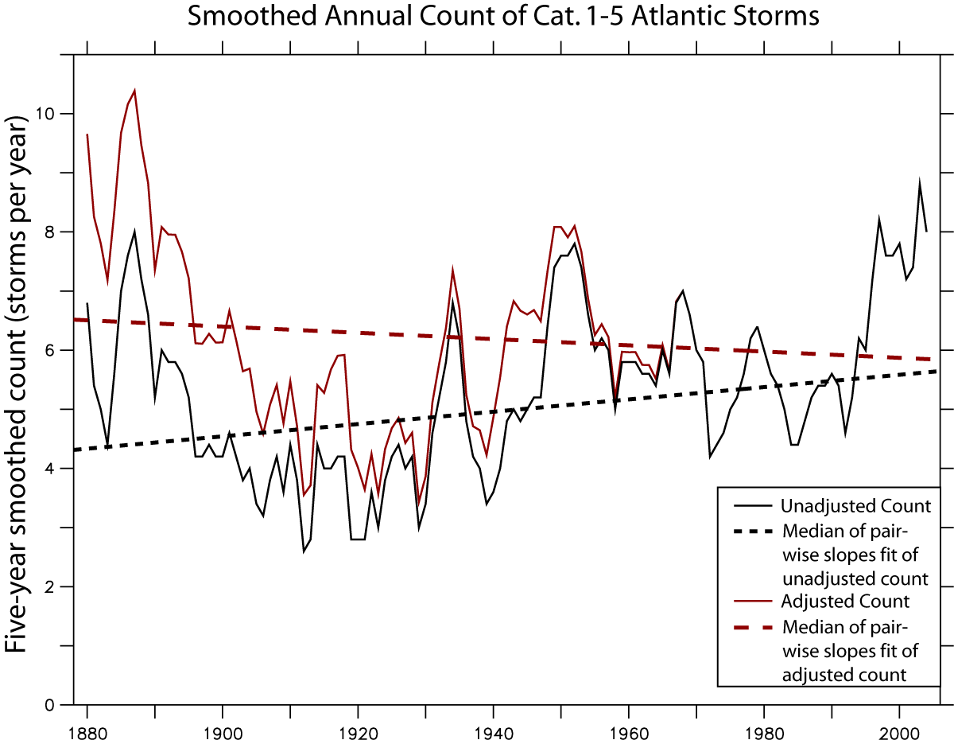
Application of Vecchi/Knutson ship-track methodology to hurricanes
1880 1900 1920 1940 1960 1980 2000
YEAR
Sources: Vecchi and Knutson, GFDL, manuscript in preparation

Slide 17
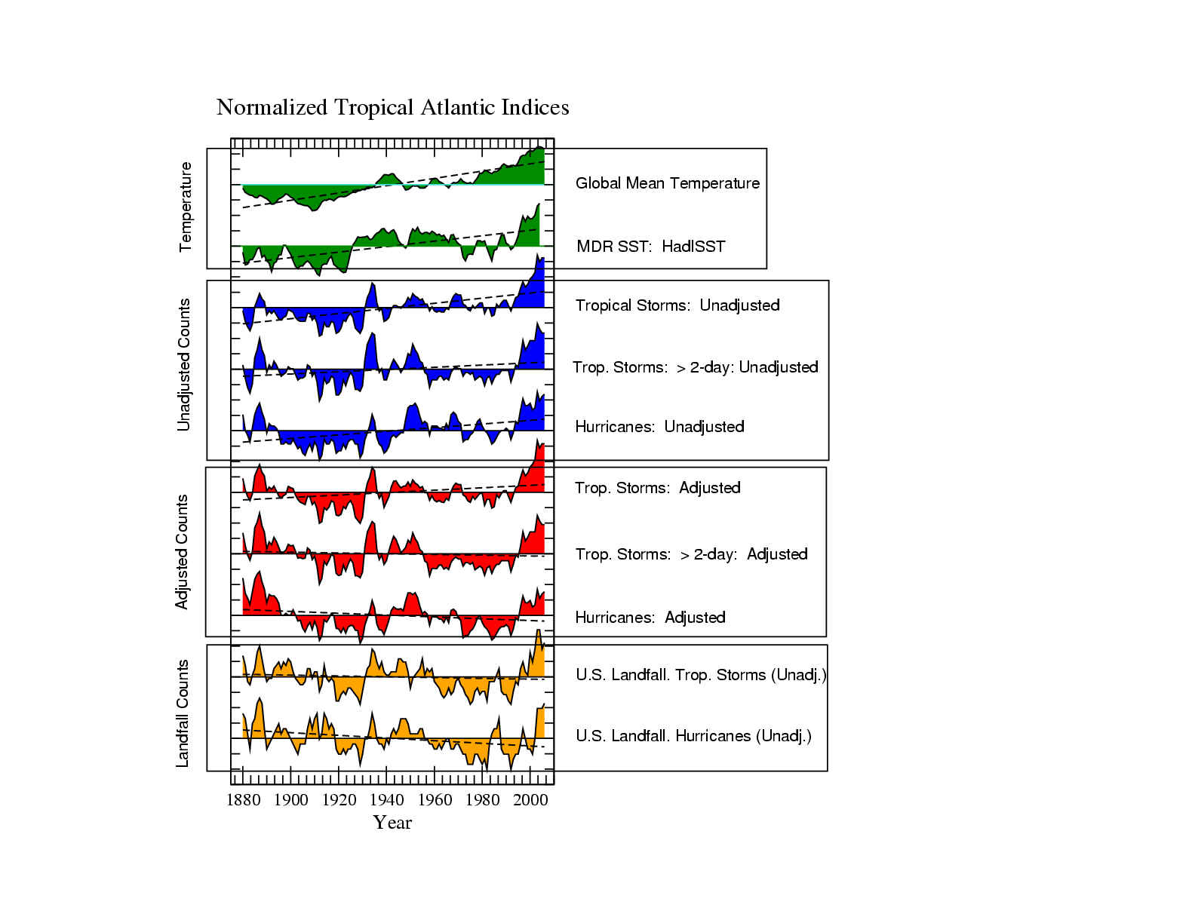
Sources:
Vecchi and Knutson (2008)
Landsea et al. (2009)
Vecchi and Knutson (in preparation)

Slide 18
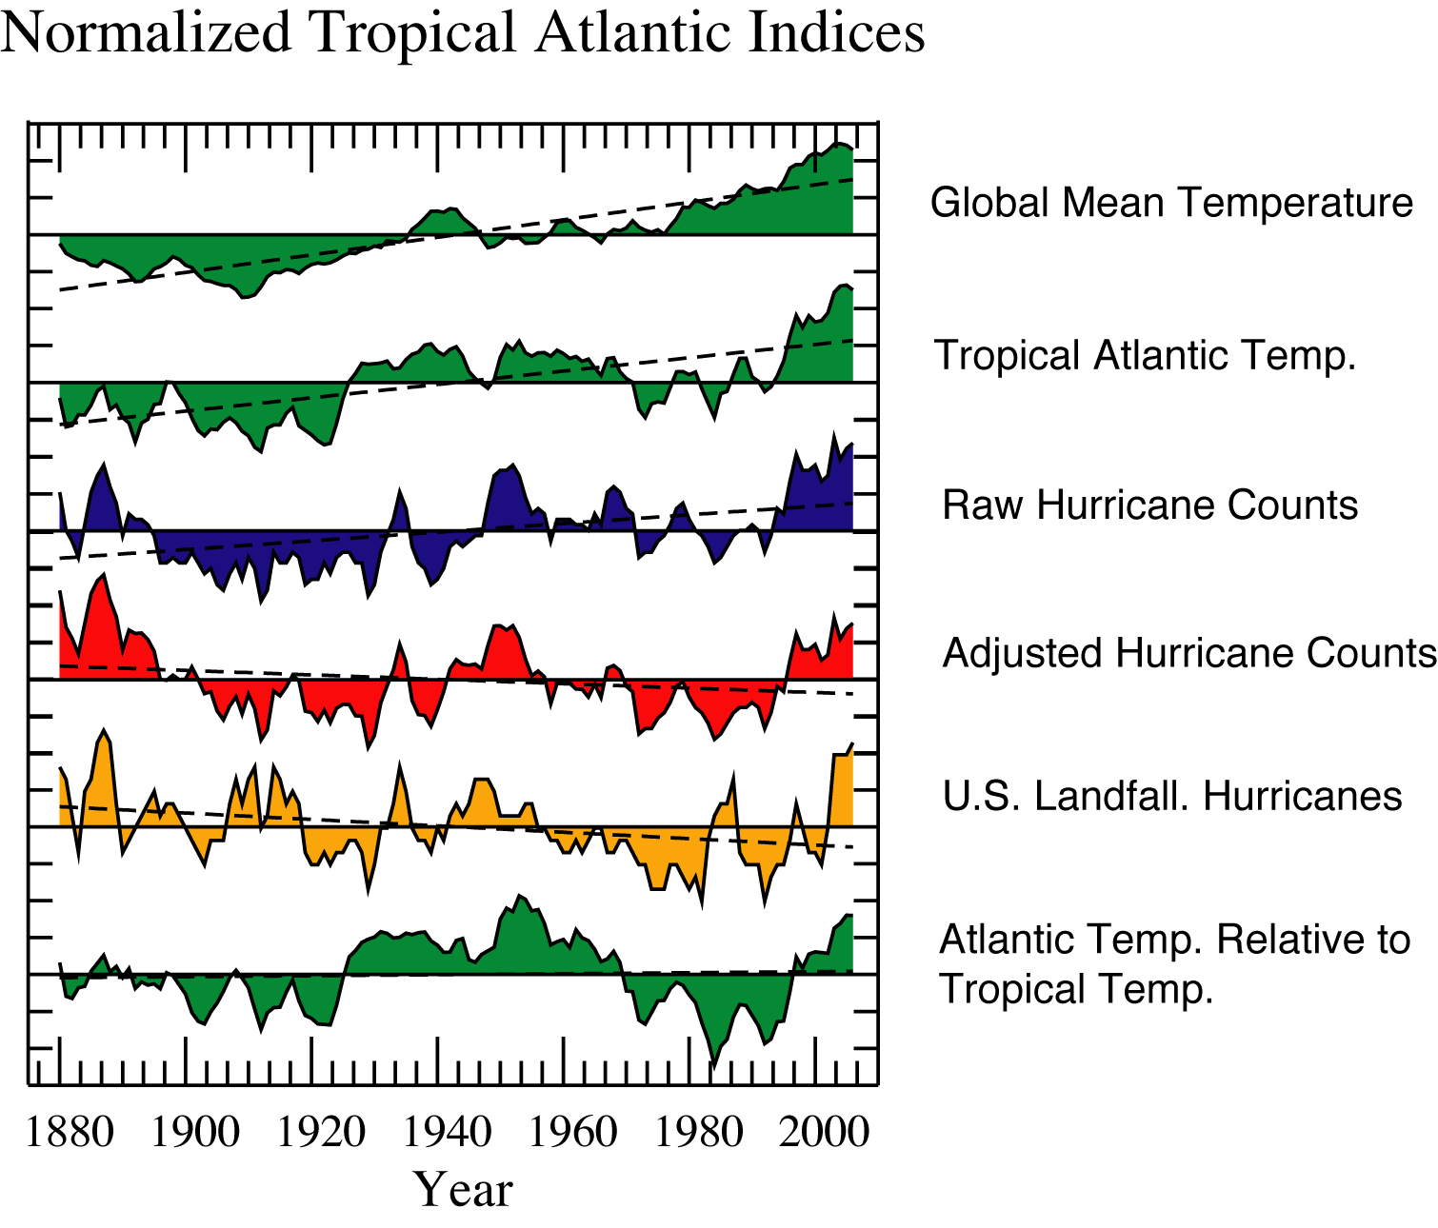

Slide 19
19
Global Tropical Cyclone Intensity Trends
There is some statistical evidence that the strongest hurricanes are getting stronger. This signal is most pronounced in the Atlantic. However, the satellite-based data for the global analysis are only available for 1981-2006. It remains uncertain whether this change exceeds the levels due to natural variability.
Quantile regression computes linear trends for particular parts of the distribution. The largest increases of intensity are found in the upper quantiles (upper extremes) of the distribution.
Source: Elsner et al., Nature, 2008.

Slide 20
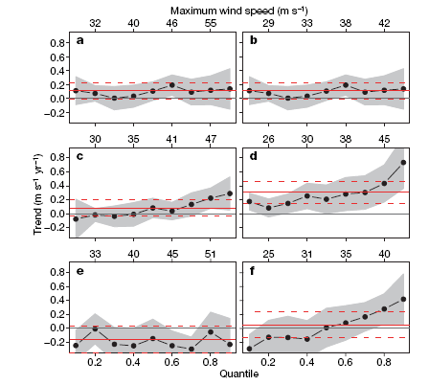
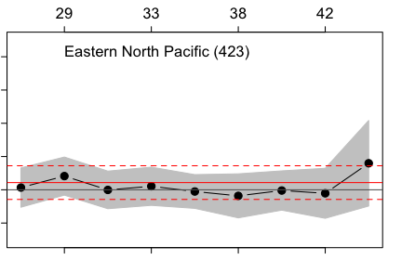
Tropical Cyclone Intensity Trends in Various Basins
b
Eastern North Pacific
Western North Pacific
Eastern North Pacific
(corrected)
There statistical evidence that the strongest hurricanes are getting stronger is most convincing for the Atlantic (1981-2006).
South Indian
Atlantic
The North and South Indian Ocean data also suggest increased intensity. Satellite view angle changes over time in those regions necessitated homogeneity adjustments.
South Pacific
North Indian
The intensity change signal is quite weak for the three Pacific basins.
Source: Elsner et al., Nature, 2008.

Slide 21
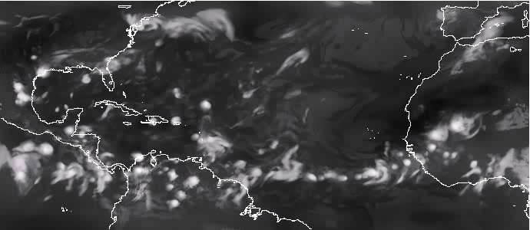
21
GFDL Zetac Model: A new high-resolution regional model for Atlantic
hurricane season simulations…
The model runs for full hurricane seasons, nudged to NCEP reanalyses.
Model grid spacing: 18km.
Model does not parameterize moist convection.

Slide 22
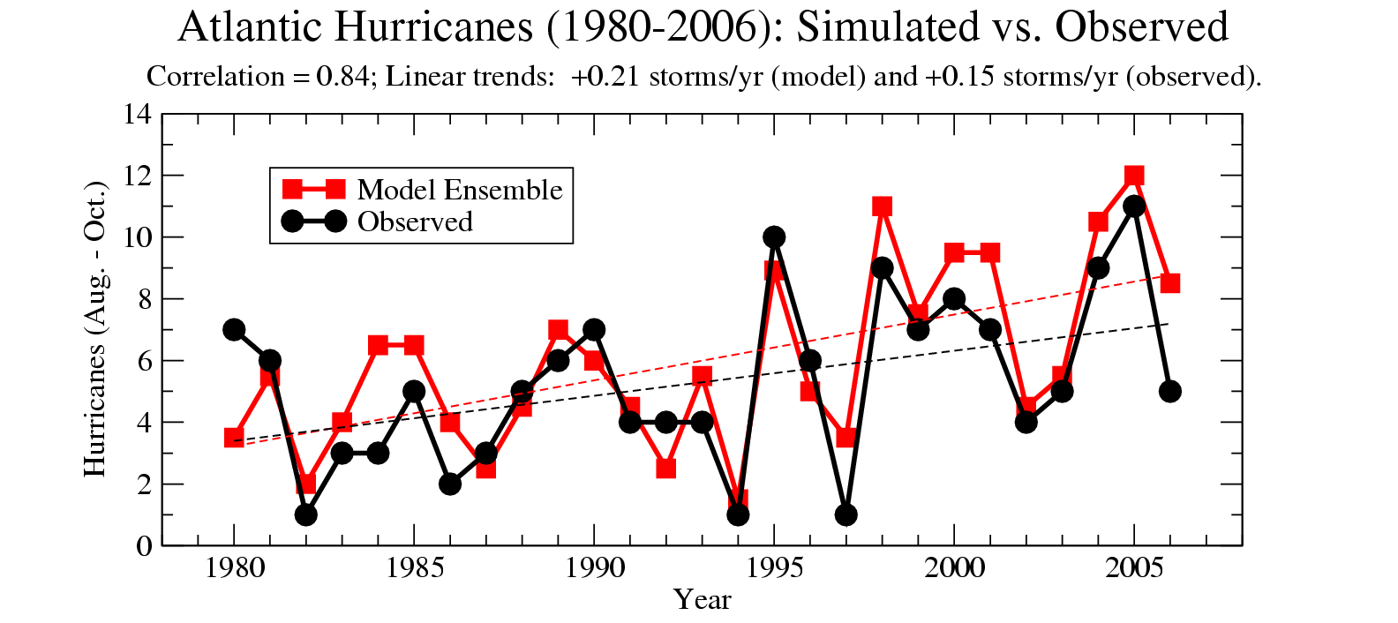
Zetac Regional Model reproduces the interannual variability and trend of Atlantic hurricane counts (1980-2006)
18-km grid model nudged toward large-scale (wave 0-2) NCEP Reanalyses
22
Source: Knutson et al., 2007, Bull. Amer. Meteor. Soc.

Slide 23
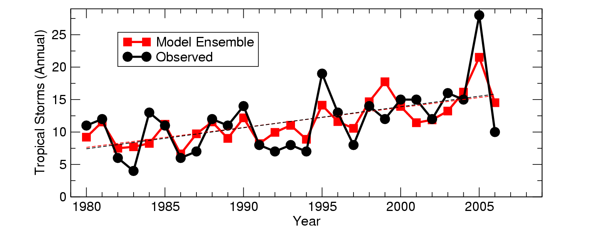
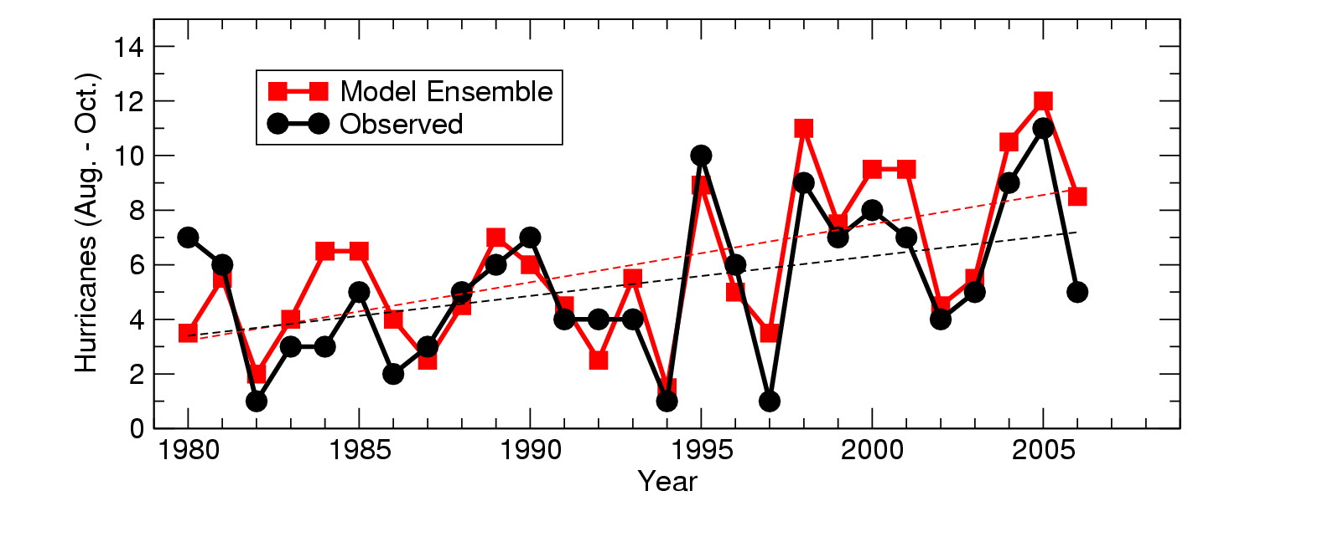
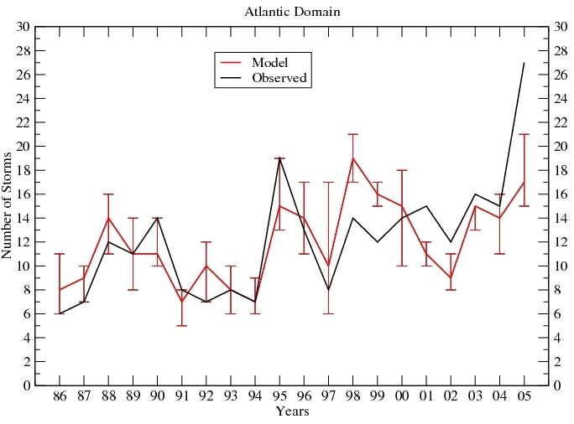
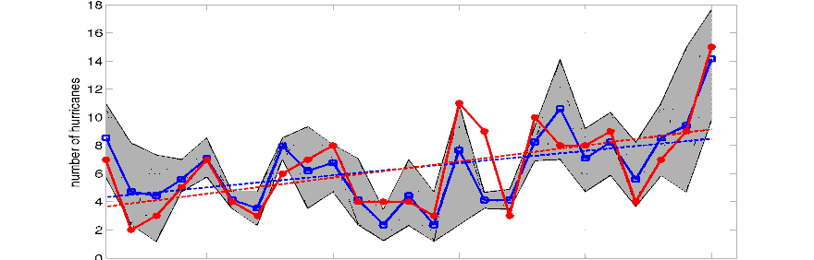
a) Emanuel et al. (2008)
Now a more robust result, as several dynamical or statistical-dynamical models can simulate recent Atlantic tropical cyclone interannual variability and trends…
b) Knutson et al. (2008)
c) LaRow et al. (2008)
1985 1990 1995 2000 2005
d) Zhao et al. (2009)
1985 1990 1995 2000 2005

Slide 24
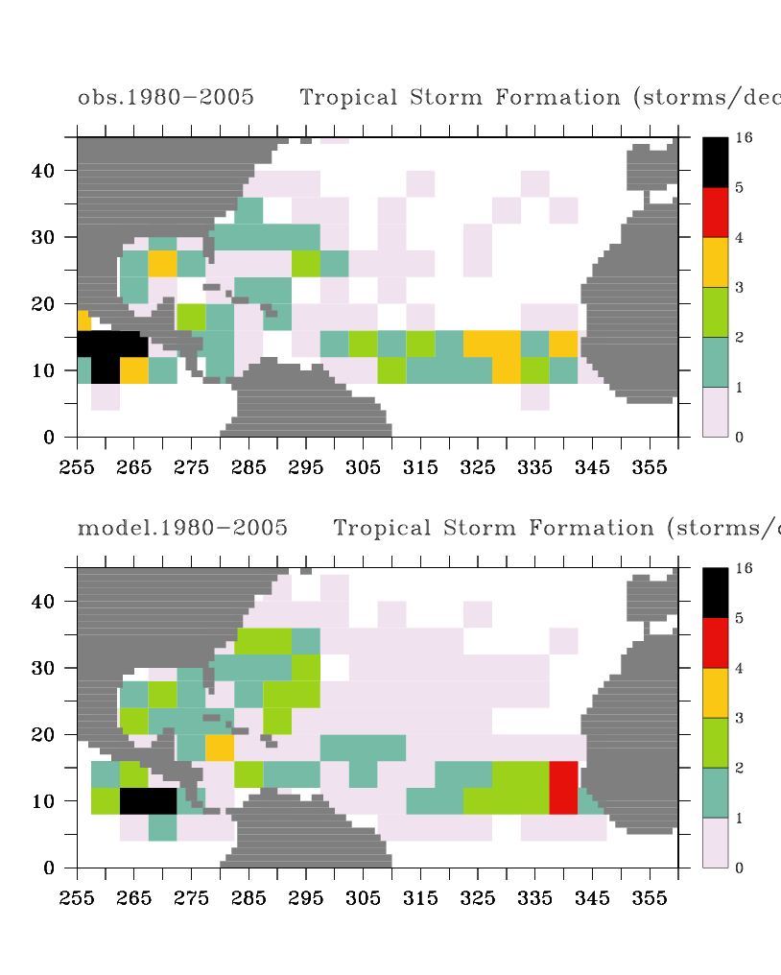
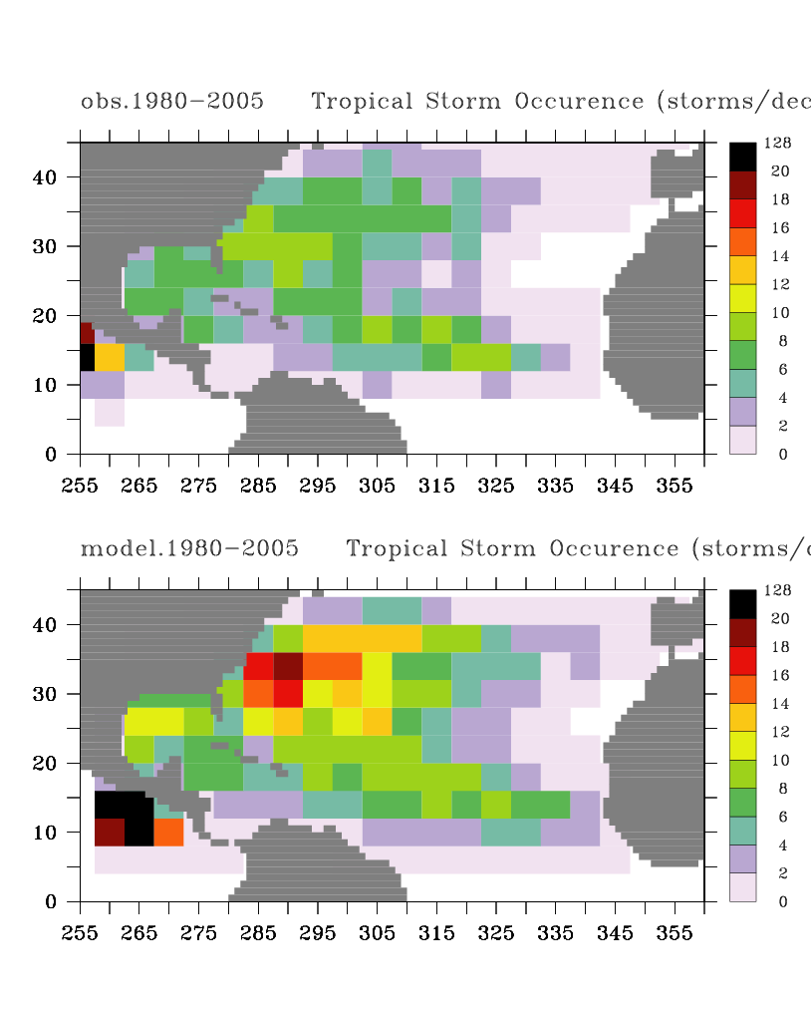
24
Zetac Regional Model Downscaling: geographical distribution of storms
Tropical Storm Formation Tropical Storm Occurrence
a) Observed b) Observed
c) Simulated d) Simulated
Note: Model uses large-scale interior nudging to NCEP Reanalysis
Source: Knutson et al., Bull. Amer. Meteor. Soc, 2007.

Slide 25
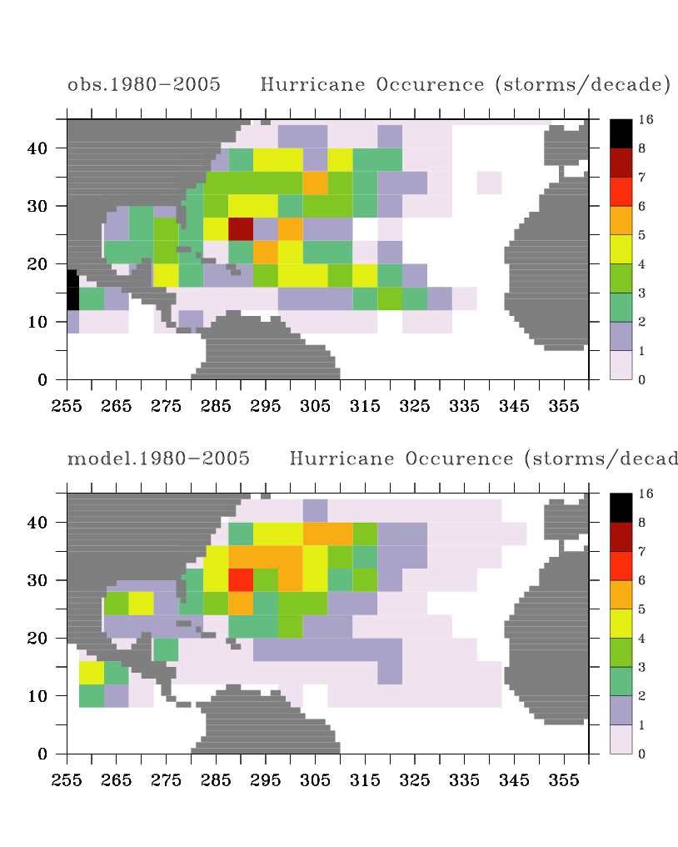
25
Zetac Regional Model Downscaling: Distribution of hurricane occurrence
Observed
Simulated
Note: Model uses large-scale interior nudging to NCEP Reanalysis
Source: Knutson et al., Bull. Amer. Meteor. Soc, 2007.

Slide 26
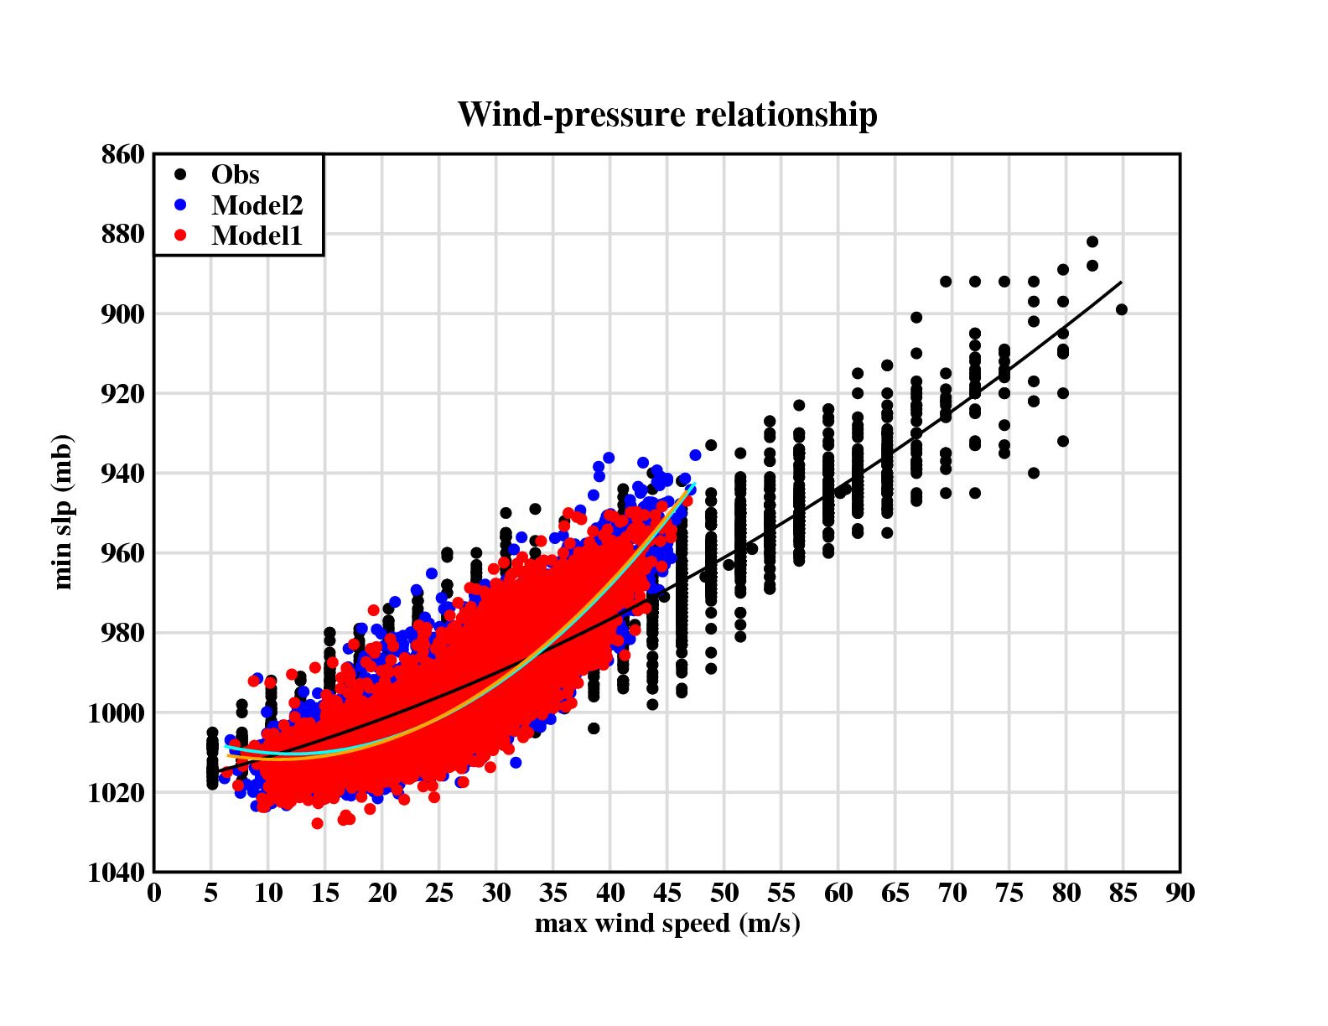
…the 18km grid model’s poor wind-pressure relation at lower central pressures leads to maximum near-surface winds of ~47 m/s, considerably lower than observed…

Slide 27
Climate Change Experiments
27
Re-run all 27 seasons with the Zetac regional model, but modify the NCEP Reanalysis forcing by a 3-D climate change perturbation field:
  Multi-model ensemble climate change. IPCC A1B scenarion. 18 CMIP3 climate models (similar to Vecchi and Soden, 2007).
  Compare modified climate runs with original 26 year control runs.
  Interannual/decadal variability and weather are unaltered from the control run.
  Multi-model ensemble climate change approach reduces problems with corruption of climate change signal by internal multi-decadal variability in the models.
Source: Knutson et al., Nature Geoscience, 2008.

Slide 28
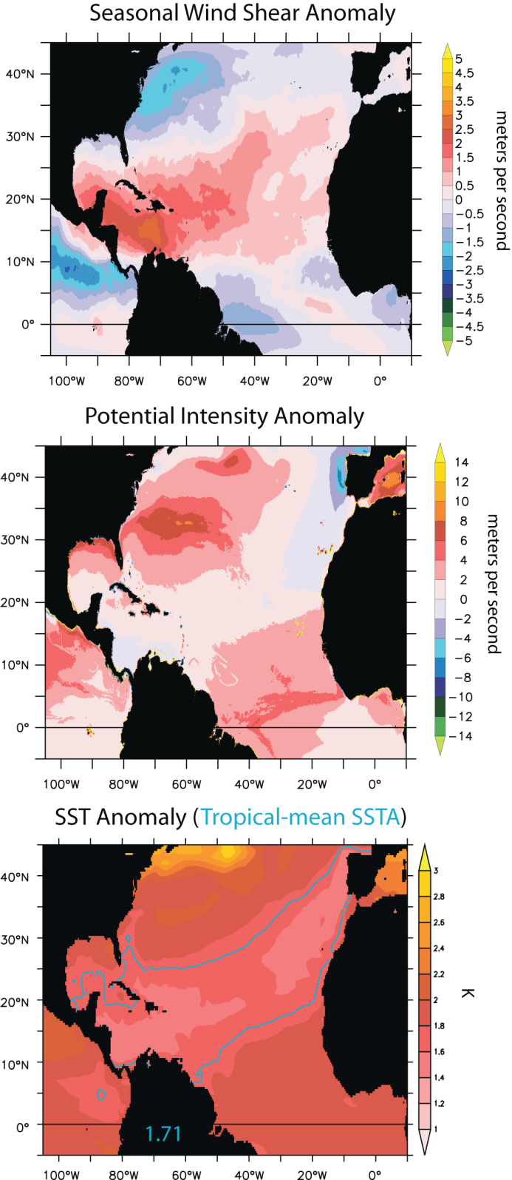
Higher shear
18-Model CMIP3 Ensemble-Mean Climate Change Projections (A1B Scenario, Late 21st century)
Higher potential intensity

Slide 29
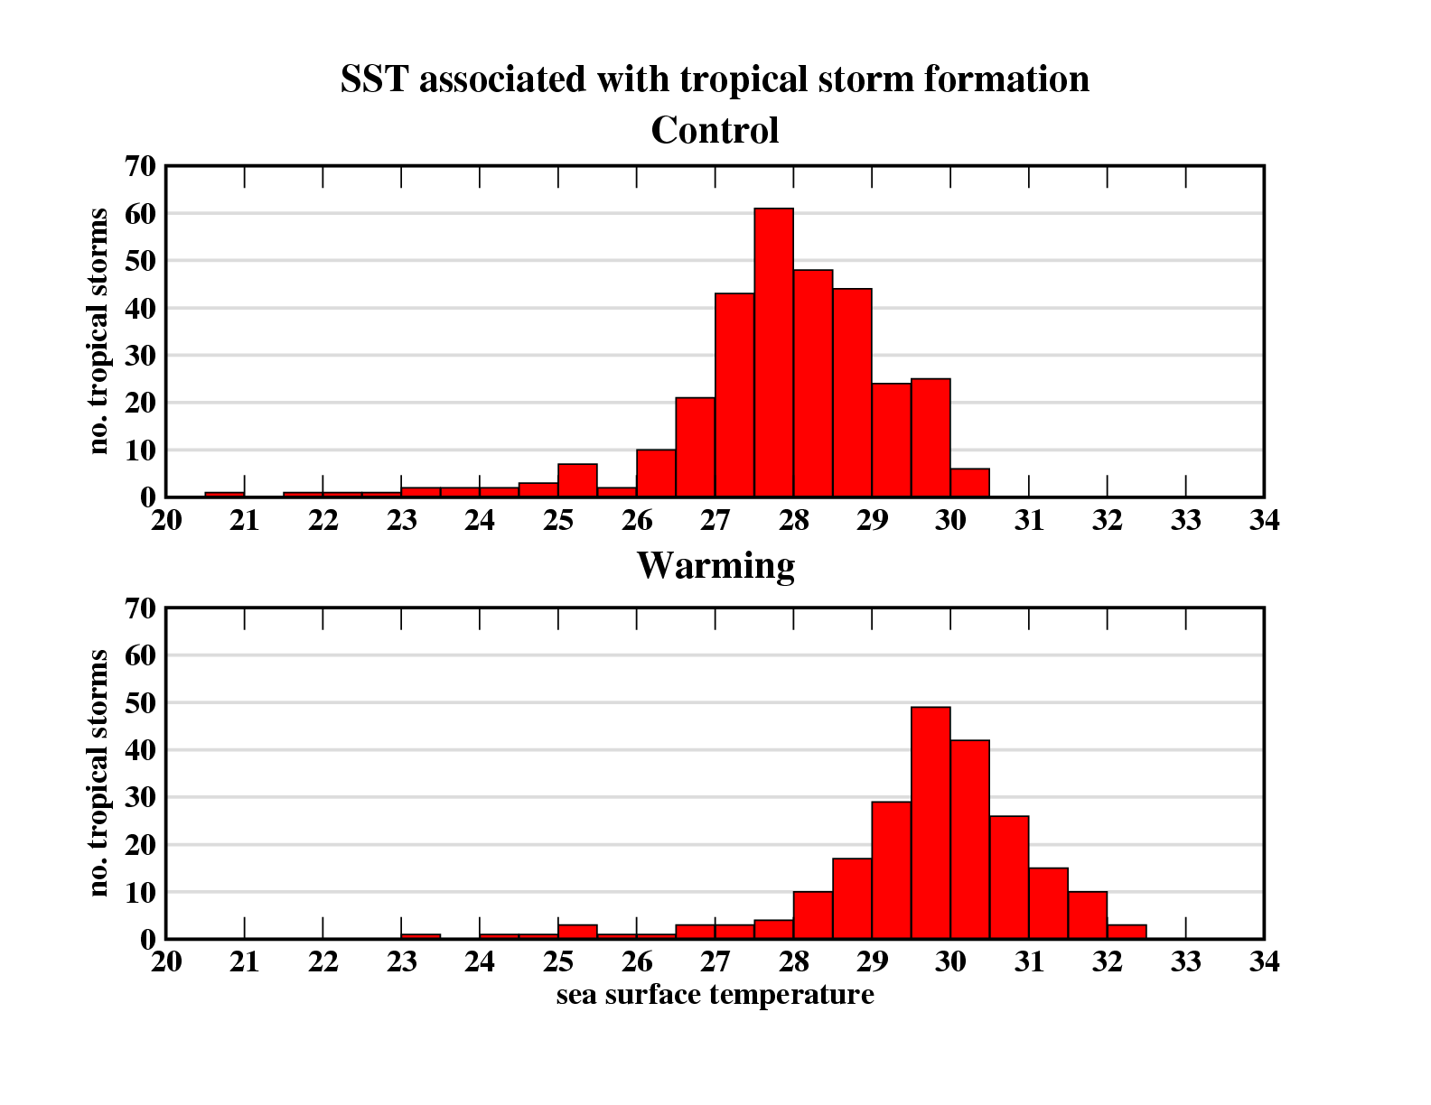
The 26.5ºC “threshhold temperature” for tropical storm formation: a climate dependent threshhold…
29
Source: Knutson et al., 2008, Nature Geoscience.

Slide 30
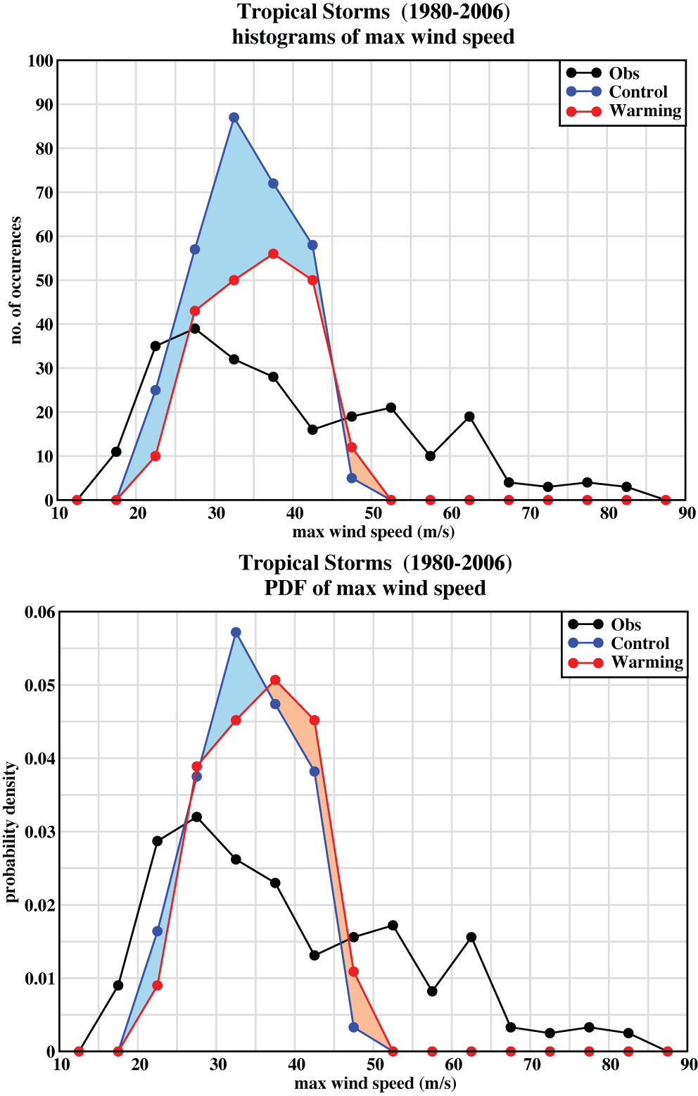
The model provides projections of Atlantic hurricane and tropical storm frequency changes for late 21st century, downscaled from a multi-model ensemble climate change (IPCC A1B scenario):
30
1) Decreased frequency of tropical storms (-27%) and hurricanes (-18%).
Storm Intensities (Normalized by frequency)
2) Increased frequency and intensity of the strongest hurricanes
(5 → 12)
4) A more consistent intensity increase is apparent after adjusting for decreased frequency
3) Caveat: this model does not simulate hurricanes as strong as those observed.
Source: Knutson et al., 2008, Nature Geoscience.

Slide 31
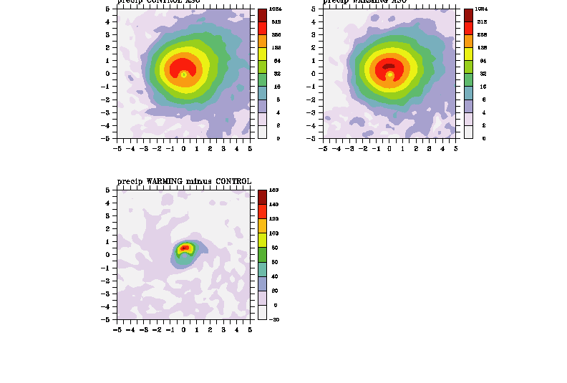
31
The new model simulates increased hurricane rainfall rates in the warmer climate (late 21st century, A1B scenario) …consistent with previous studies…
Present Climate
Warm Climate
Rainfall Rates (mm/day)
Warm Climate – Present Climate
Avg. Rainfall Rate Increases:
50 km radius: +37%
100 km radius: +23%
150 km radius: +17%
400 km radius: +10%
Average Warming: 1.72ºC
Source: Knutson et al., 2008, Nature Geoscience.

Slide 32
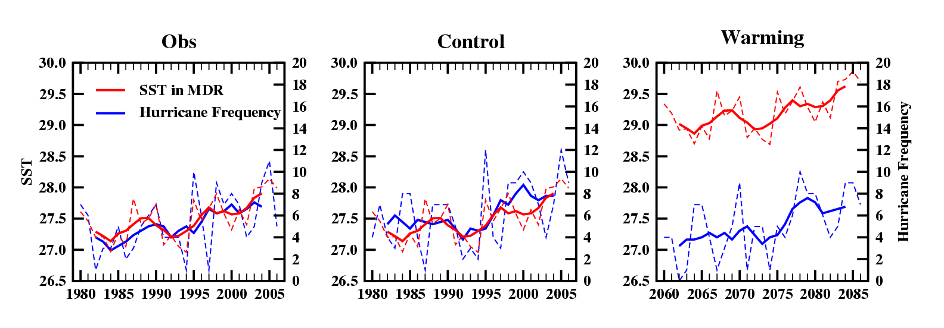
32
The control model reproduces the observed close relationship between SST and hurricane frequency (1980-2006), but this statistical relationship does not hold for future human-caused warming in the model.
Hurricane frequency actually decreases by 18% in the warm climate case… although the model does not simulate hurricanes as intense as observed.
Lesson: Caution using correlations from the present climate to make future climate projections…
Source: Knutson et al., Nature Geoscience (2008).

Slide 33
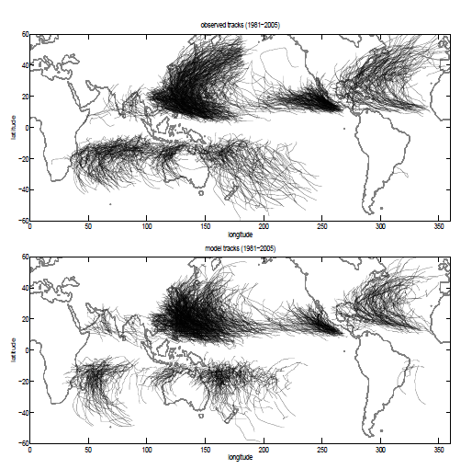
GFDL HIRAM 50km grid global model:
Simulated vs Observed Tropical Storm Tracks (1981-2005)
Source: Zhao et al. J. Climate (2009)

Slide 34
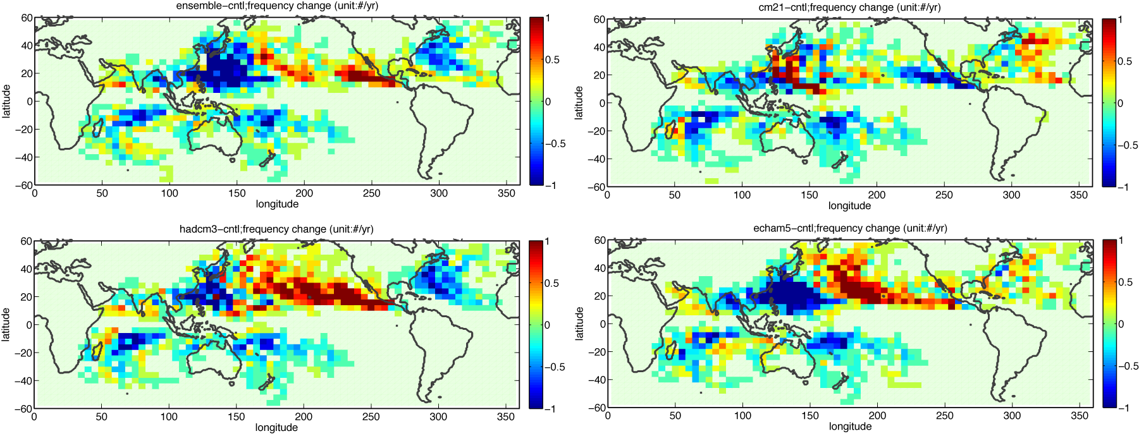
Tropical cyclone activity: Late 21st century projected changes
GFDL 50-km HIRAM, using four CMIP3-based projections of SSTs.
18-model CMIP3 Ensemble
GFDL CM2.1
HadCM3
ECHAM5
Red/yellow = increase
Blue/green = decrease
Unit: Number per year
Regional increases/decreases much larger than global-mean changes.
Pattern depends on details of SST change.
Source: Auxiliary figure from Zhao, Held, Lin and Vecchi (J. Climate, 2009)

Slide 35
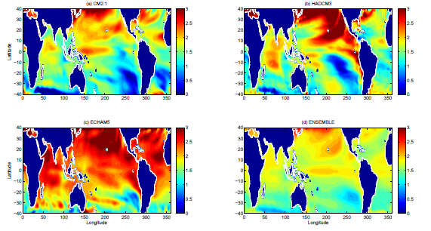
Global Model Tropical Cyclone Climate Change Experiments: Use A1B Scenario late 21st century projected SST changes from several CMIP3 models
GFDL CM2.1
HadCM3
ECHAM5
CMIP3 18-model Ensemble
Unit: Deg C
Source: Zhao, Held, Lin, and Vecchi (J. Climate, 2009)

Slide 36
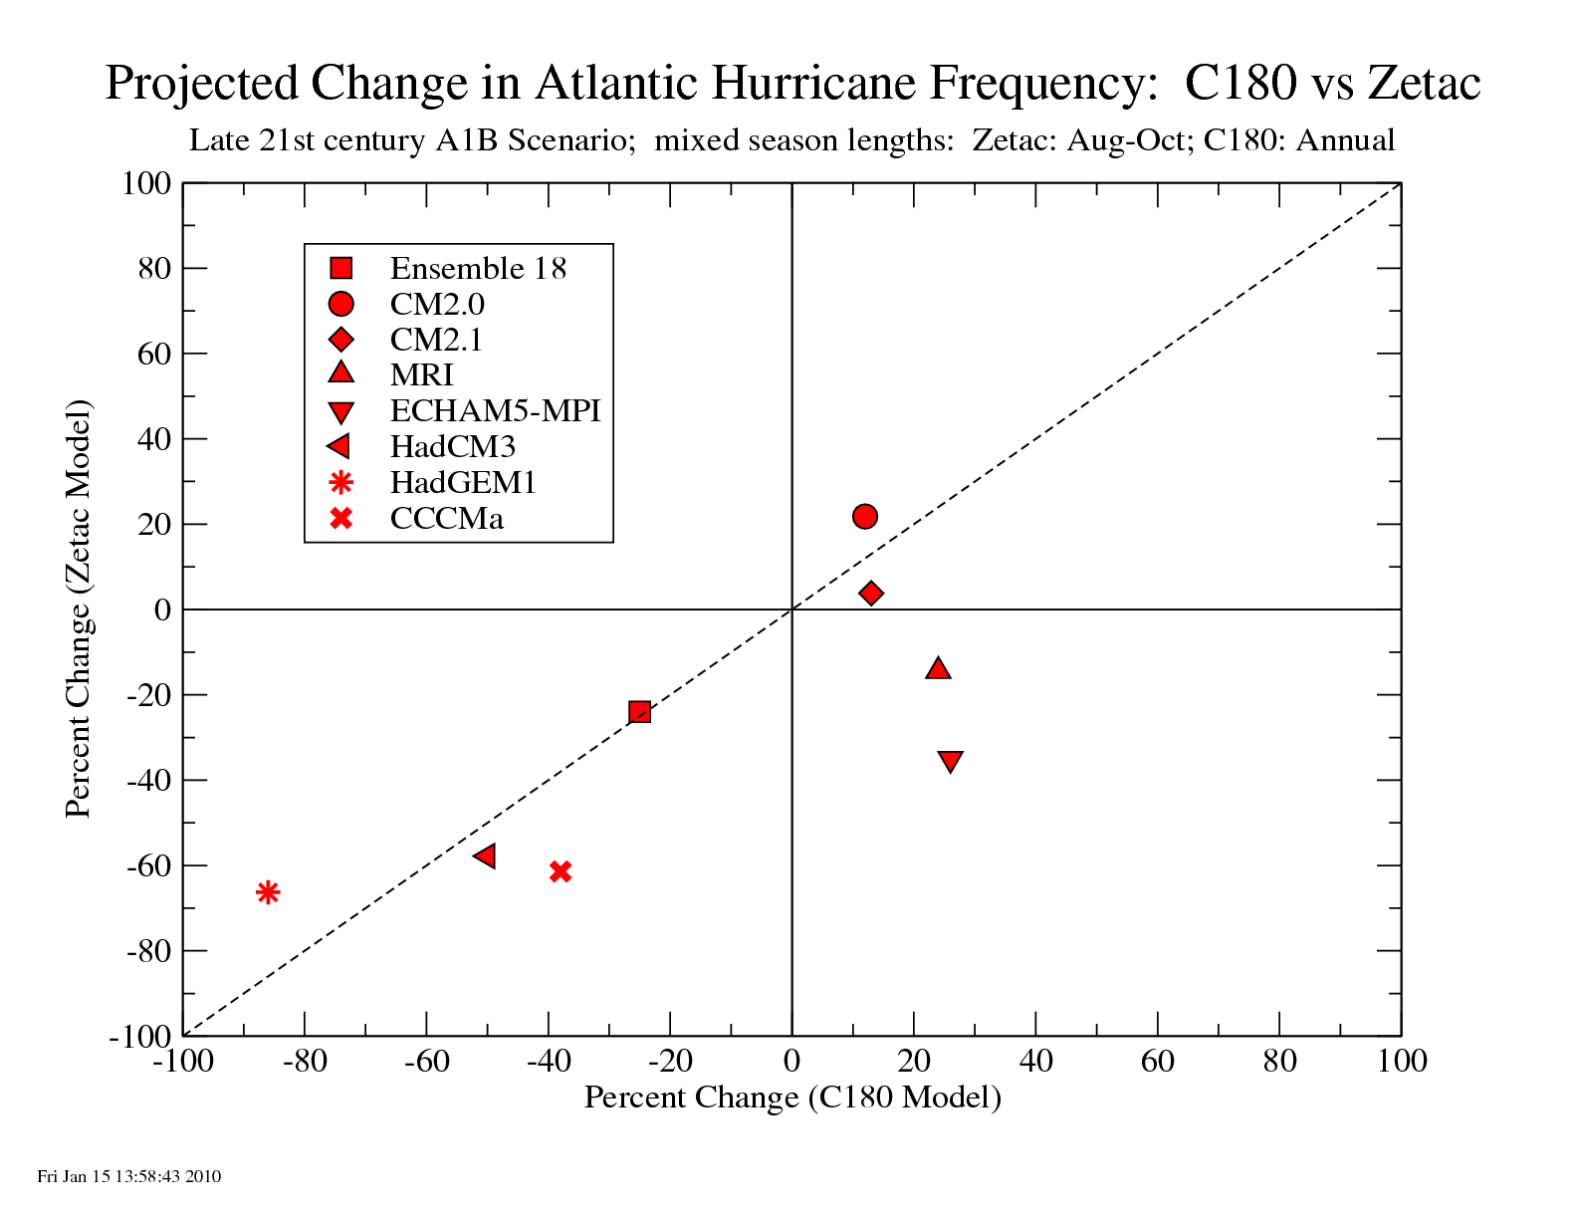
Zetac and C180 projected hurricane changes are fairly comparable for 6 of 8 common cases tested so far…suggesting that uncertainty due to downscaling may be dominated by the climate model inputs, rather than the downscaling models.
C180 results provided by Ming Zhao, GFDL, see Zhao et al. 2009.

Slide 37
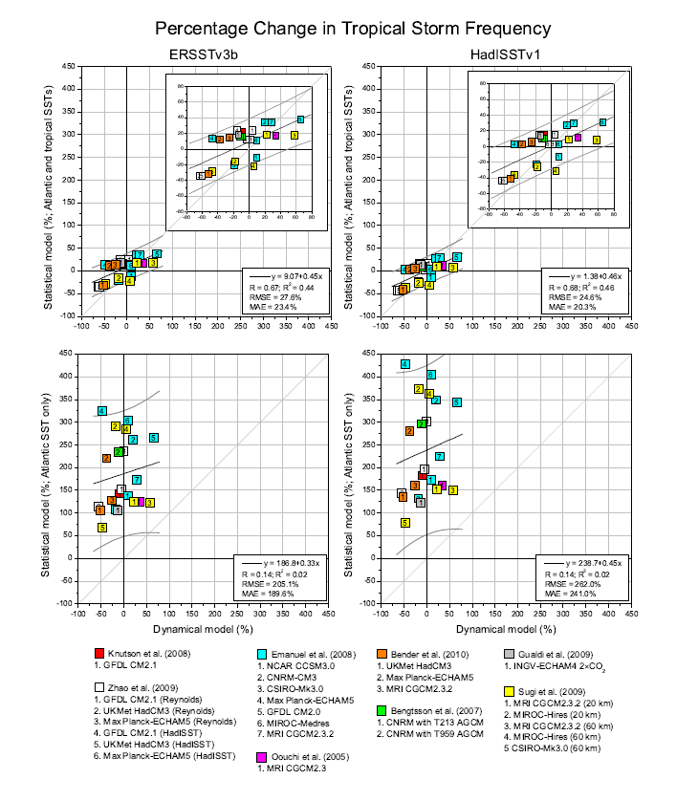
What environmental variables best ‘explain’ differences in Atlantic Tropical Storm Frequency projections?
Statistical model using local Atlantic MDR SST
Statistical model using Atlantic and Tropical SST
Dynamical Model Projection (%)
Dynamical Model Projection (%)
Source: Villarini et al. (J. Climate) in press.

Slide 38
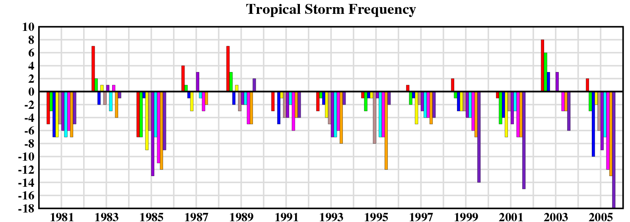
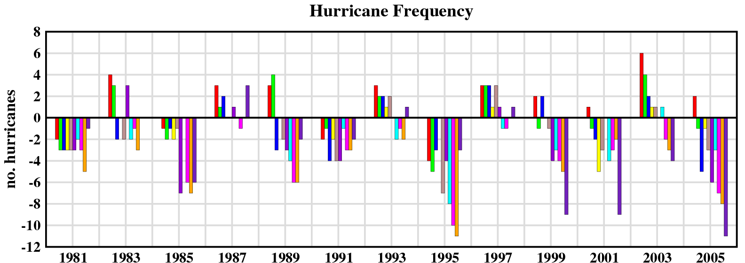
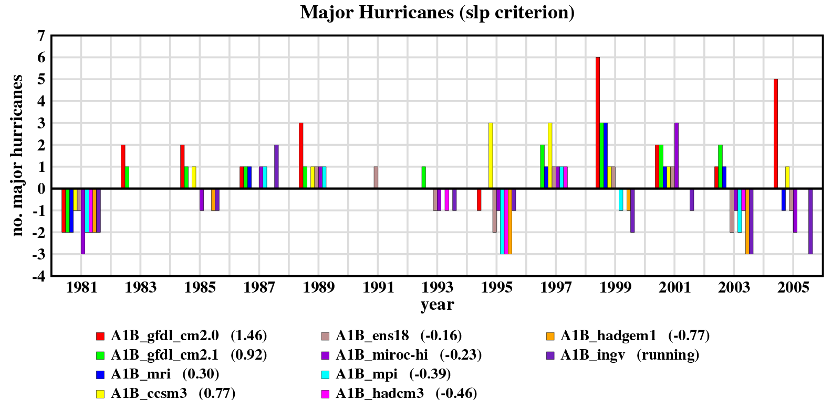
38
Climate Model Dependence: Zetac downscaling (Warm minus Control)
Control: 11.08 /yr
Tropical Storms:
18-model ens.: -33%
Increasing Storm Intensity
Control: 6.38 /yr
Hurricanes:
18-model ens.: -24%
Major Hurricanes:
18-model ens.: -5%
Control:1.31 /yr
Source: Knutson, Sirutis, et al., unpublished

Slide 39
Intensities of the strongest storms?
39
Since the 18-km grid zetac model fails to simulate wind speeds greater than ~47 m/s, a second downscaling step is necessary.
  Use GFDL Hurricane Prediction System (operational at NCEP) to re-simulate all individual storms from the zetac regional climate model runs (control and warm climates).
  So far only done for the Atlantic basin…

Slide 40
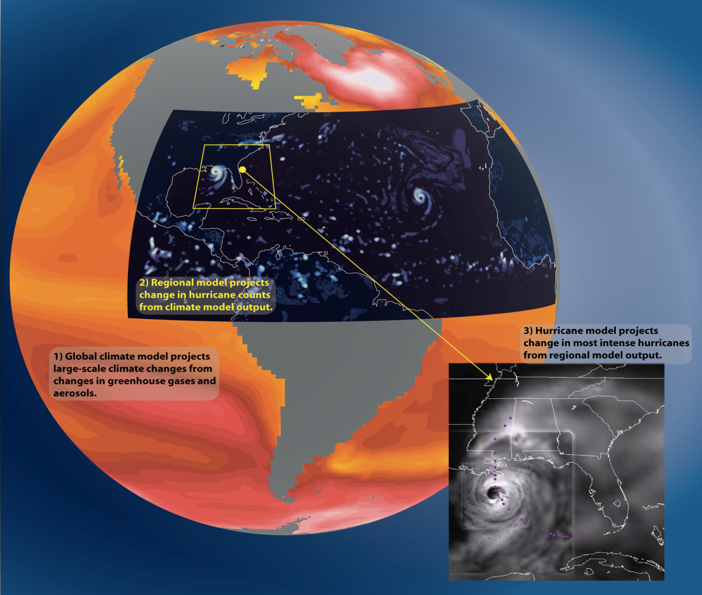
Modeled Impact of Anthropogenic Warming on the Frequency of Intense Atlantic Hurricanes, Bender et al., Science, 2010.

Slide 41
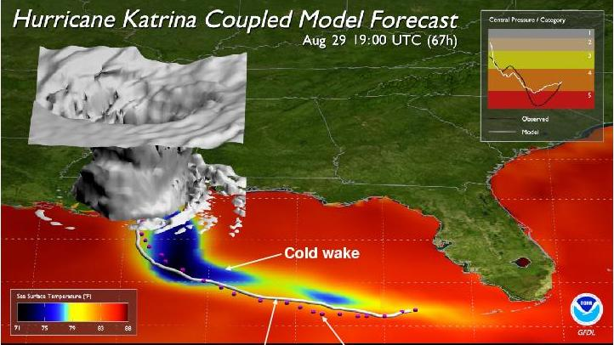
41

Slide 42
EXPERIMENTAL DESIGN
42
Latest version of the GFDL Hurricane Prediction system used for this study (Operational at NCEP and FLEET since 1995).
Every Zetac Regional Climate model tropical storm was downscaled to the GFDL hurricane prediction model for the 27 years from 1980 to 2006 (control and warm climate).
All forecasts were begun 3 days before maximum intensity obtained by the Zetac model or when Zetac model first designated system as tropical storm (if less then 3 days before maximum intensity).
GFDL Hurricane Model runs were 5 days duration.

Slide 43
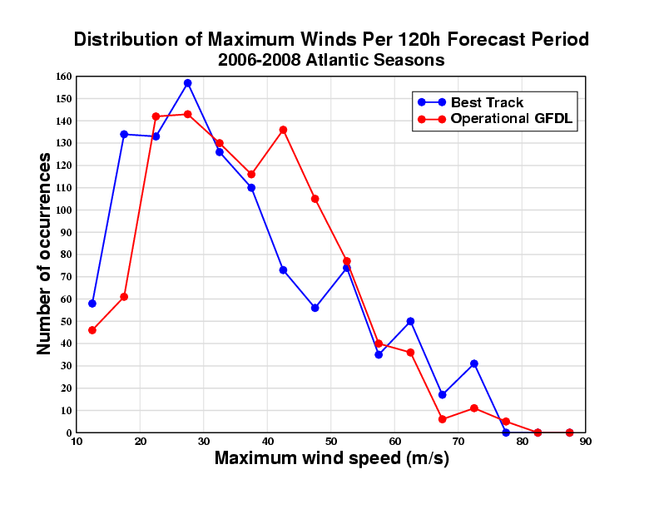
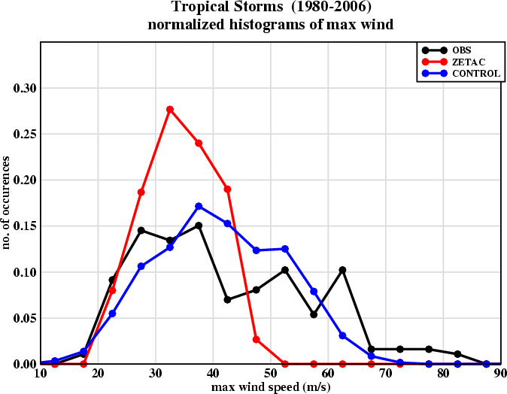
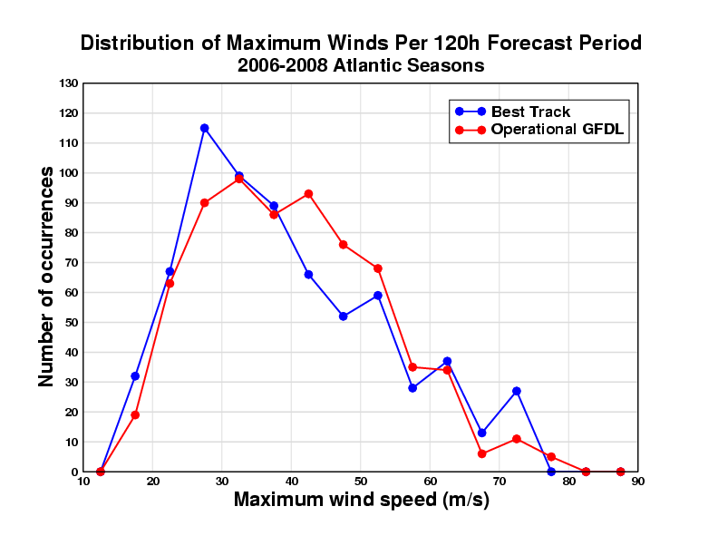
43
The GFDL Operational Hurricane Prediction System simulates a realistic distribution of TC intensities in both operational and climate mode…
Control climatology of Intensities:
Operational Performance:
Simulated distributions of maximum wind speeds, downscaling from NCEP Reanalysis
18km grid Zetac regional climate model
9 km GFDL hurricane model (2nd downscaling step)
observed
NCEP version of the GFDL
Operational Model
Source: Bender et al., Science 2010.

Slide 44
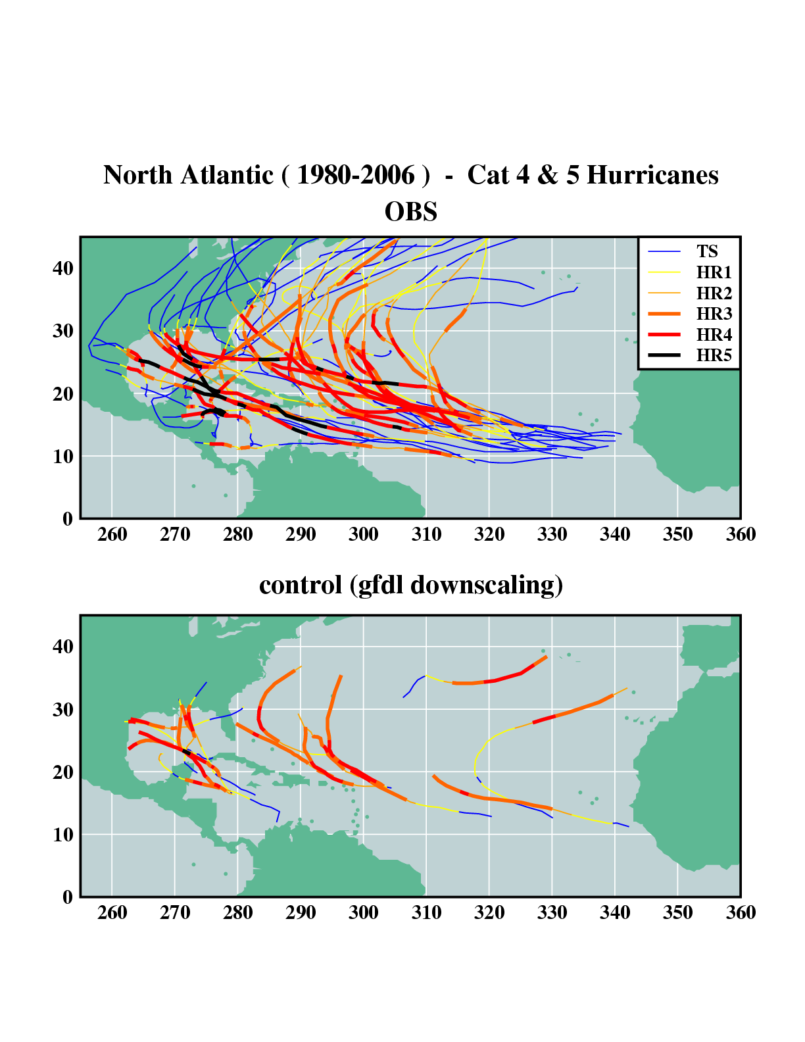
44
Note: GFDL hurricane model downscaling runs (U.S. Navy version) are limited to 5-day duration.
Source: Bender et al., Science, 2010.

Slide 45
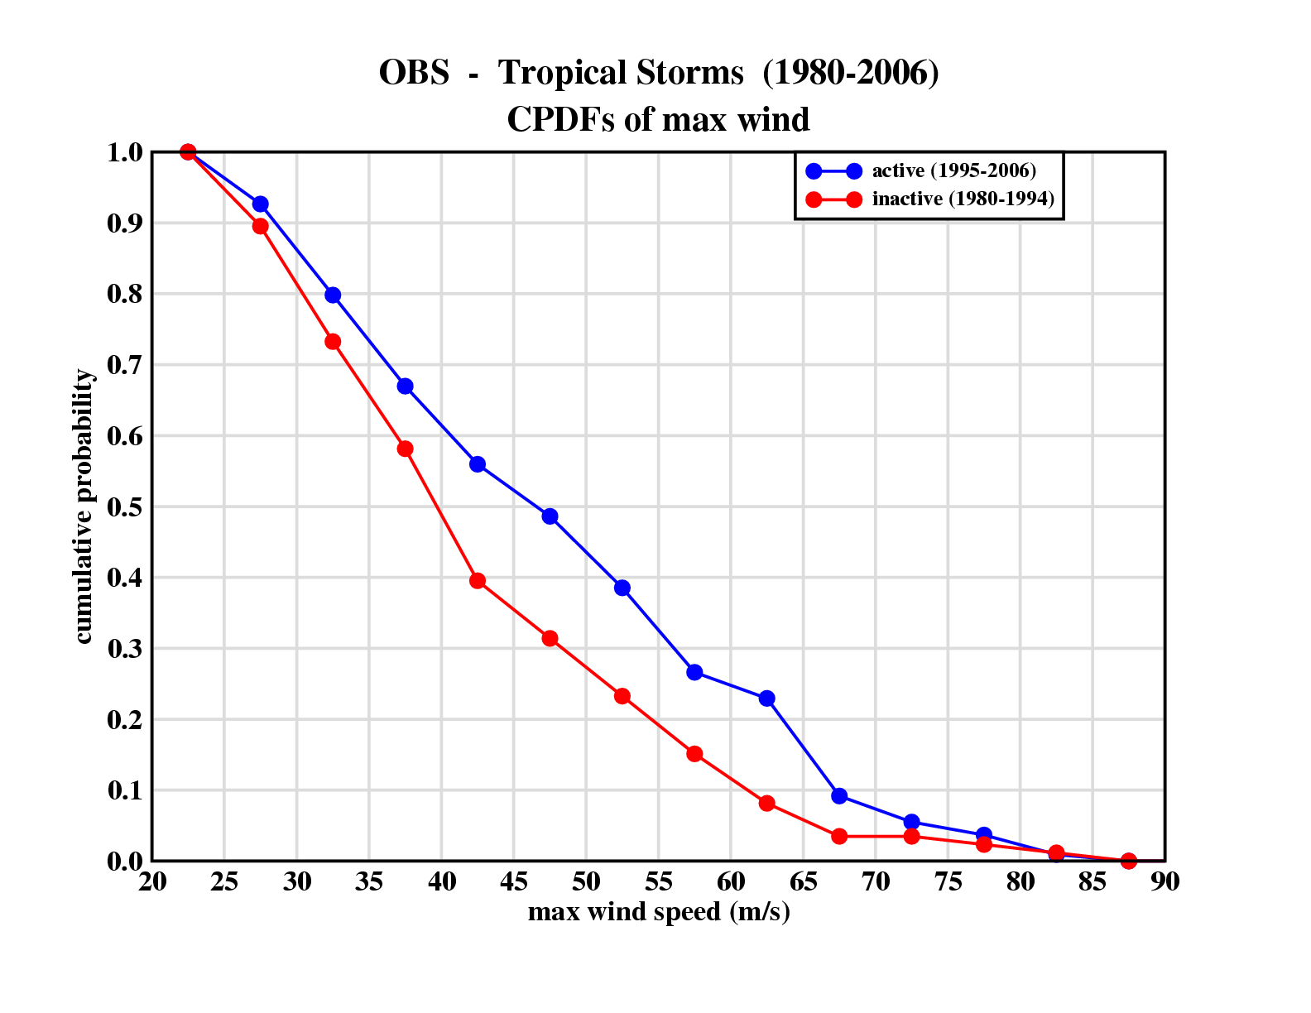
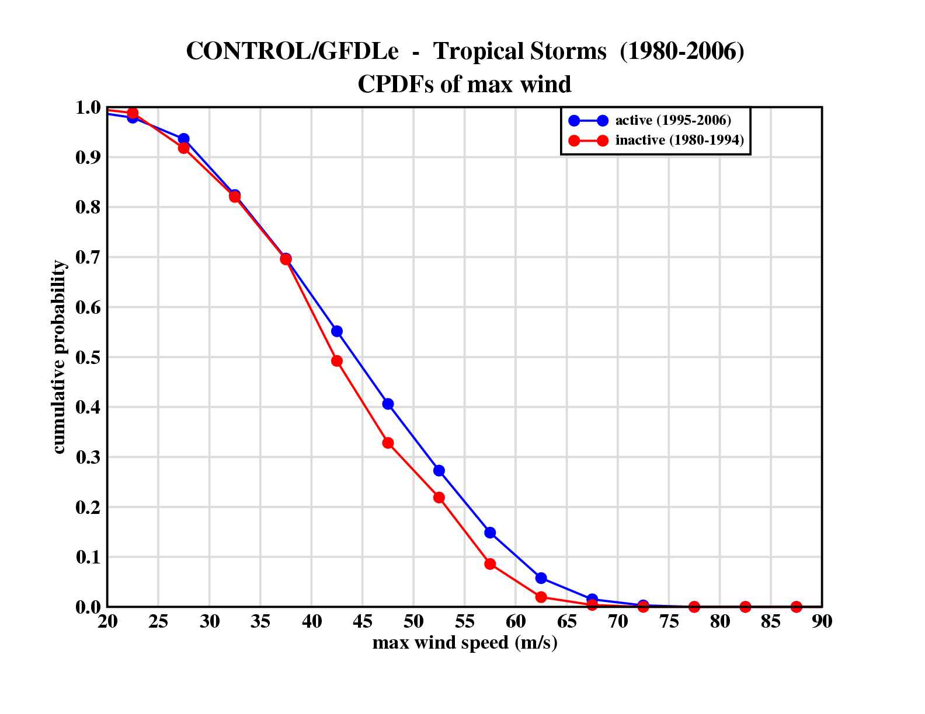
Observed intensities
Distributions (CDF’s) of Atlantic tropical cyclone intensities (1980-2006).
Red: 1980-1994 (inactive)
Blue: 1995-2006 (active)
Fraction of storms above indicated intensity
Active era
Inactive era
Simulated intensities
Fraction of storms above indicated intensity
GFDL Hurricane Model intensity distribution is also shifted to higher intensities in active years, but the difference is smaller than observed.
Active era
Inactive era
Maximum Wind Speed (m/s)
Source: Bender et al., Science, 2010.

Slide 46
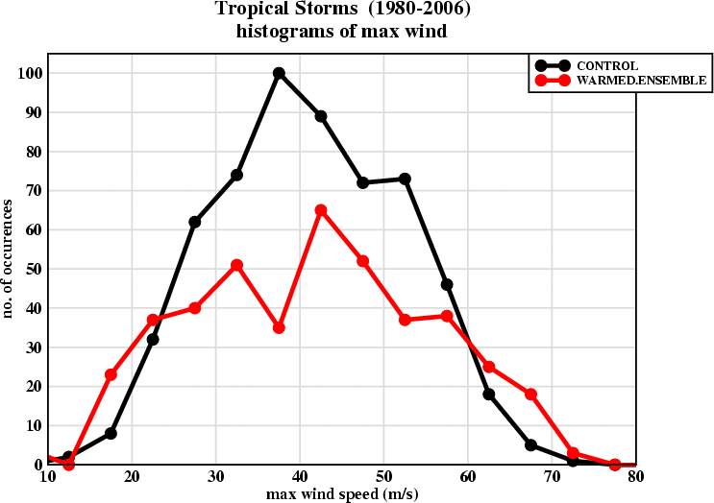
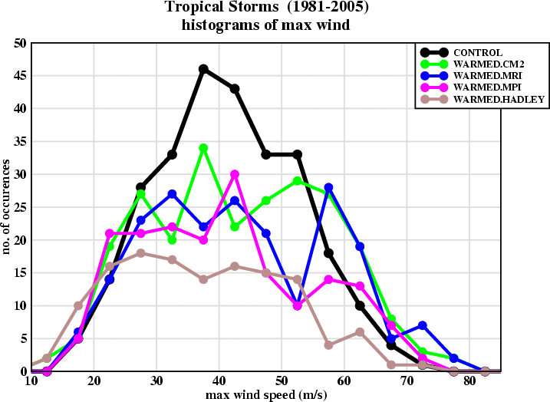
In a warmer climate (late 21st century A1B scenario) the hurricane model simulates an expanded distribution of Atlantic hurricane intensities.
46
Control
The strongest hurricanes increase in number for the downscaled ensemble-mean climate warming…
…and increase for 3 of 4 individual climate models tested.
Source: Bender et al., Science, 2010.

Slide 47
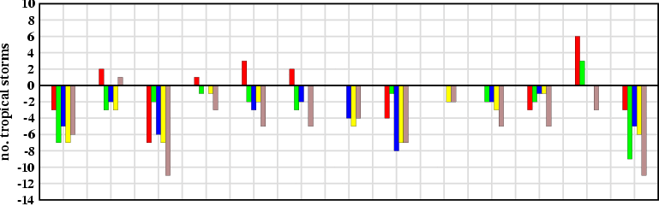




Changes in Atlantic Hurricane Counts by Intensity Class: Late 21st century A1B Projection
47
Tropical Storms
GFDL CM2.1
MRI
18-Model Ensemble
MPI
HadCM3
Ensemble: -27%. Range: - 48% to - 3%
All Hurricanes (Cat 1-5)
Tropical storms and hurricanes consistently decrease in number in the warmer climate, but…
Hurricane Intensity Class
Ensemble: -33%. Range: - 60% to -7.5%
Major Hurricanes (Cat 3-5)
Ensemble: -18%. Range: - 60% to +40%
Cat 4-5 Hurricanes (>131 mph)
Ensemble: +75%. Range: - 53% to +110%
…the rarer most intense simulated hurricanes occur up to 3 times as often in the warmer climate, and increased for 3 of 4 individual models
Most Intense Hurricanes (>145 mph)
Ensemble: +220%. Range: - 60% to +180%
1981 1983 1985 1987 1989 1991 1993 1995 1997 1999 2001 2003 2005
BASE YEAR
Source: Bender et al., Science, 2010.

Slide 48




Category 4-5 Hurricanes (27 Seasons); GFDL Hurricane Model (2 Versions)
Downscale of Zetac Control and CMIP3 Ensemble Climate Change
NCEP Version (GFDL)
NAVY Version (GFDN)
Degrees Latitude
Control Climate
Control Climate
Late 21st Century Warmed Climate
Late 21st Century Warmed Climate
Degrees Longitude East
Degrees Longitude East
Source: Bender et al., Science, 2010.

Slide 49





Control Climate
NCEP VERSION (GFDL)
Degrees Latitude
Category 4-5 Hurricanes
(13 seasons, downscaling 4 indiv. CMIP3 models )
Degrees Longitude East
Late 21st Century Projections
Late 21st Century Projections
GFDL CM2.1
MPI
MRI
HadCM3
Source: Bender et al., Science, 2010.

Slide 50

Anomaly Fields from the 4 individual CMIP3 models

Slide 51

SUMMARY OF PROJECTED CHANGE
Cat 4+5 frequency: 81% increase, or 10% per decade
Estimated net impact of these changes on damage potential: +28%
Colored bars show changes for the18 model CMIP3 ensemble (27 seasons); dots show range of changes across 4 individual CMIP models (13 seasons).
Source: Bender et al., Science, 2010.

Slide 52

Comparison of Recent Atlantic Hurricane Trends vs 21st Century Projected Trend Rates (in percent per decade)
Figure courtesy Gabe Vecchi, GFDL./NOAA

Slide 53


Emergence Time Scale: If the observed Cat 4+5 data since 1944 represents the noise (e.g. through bootstrap resampling), how long would it take for a trend of ~10% per decade in Cat 4+5 frequency to emerge from noise? Answer: ~60 yr (by then 95% of cases are positive)
Instead, assume residuals from a 4th order polynomial: 55 yr
Instead, resample chunks of length 3-7 yr: 65-70 yr
Source: Bender et al., Science, 2010.

Slide 54


The issue of lower stratospheric / upper tropospheric temperature trends:
Can lower stratospheric or tropopause transition layer (TTL) temperatures (apparently cooling) affect tropical storm frequency or hurricane intensity? Emanuel statistical/dynamical downscaling: yes for both. Current GFDL dynamical models: apparently not for tropical storm frequency, not clear for intensity (upper tropospheric temperatures affect hurricane intensity in the GFDL models). Also, are NCEP potential intensity trends since 1980 reliable or do they suffer from inhomogeneity problems?
Statistical/Dynamical Downscaling of Atlantic Tropical Storm Frequency (1870-2005)
Potential Intensity trends since 1980 from NCEP Reanalysis
Source: K. Emanuel, AMS Hurricanes and Tropical Meteorology Conference abstract, 2010.

Slide 55

NCEP Reanalysis: large rising trends in Potential Intensity (1982-2007) which are not widely present in a global model forced with observed SSTs.
Source: G. Vecchi, manuscript in preparation, 2011.

Slide 56

Simulating past variability in Atlantic tropical cyclone activity
Progress in simulating past Atlantic hurricane / tropical storm frequency variability using dynamical and statistical/dynamical models.
Left: examples for the Atlantic basin, using high resolution atmospheric models; regional dynamical downscaling models; and statistical/dynamical techniques.
and (b) use NCEP Reanalyses.
(c) uses SSTs (d) uses SSTs, with greenhouse gases and ozone.
Current questions: Is a strong cooling of tropopause transition layer (TTL) necessary to simulate the Atlantic tropical storm trends over this period? Has the potential intensity increased since 1980 in all TC basins?
Source: Knutson et al., Nature Geoscience (2010).

Slide 57



The 50 km grid GFDL HIRAM global model is not systematically under-predicting historical trends in hurricane counts
corr=0.83
North Atlantic
Southwest Pacific corr=0.28
corr=0.62
East Pacific
Hurricane counts for each basin are normalized by a
time-independent
multiplicative factor
corr=0.52
West Pacific
Correlations of model and observed counts are insignificant for the Indian Ocean basins (not shown).
red: observations
blue: HiRAM ensemble mean
shading: model uncertainty
Source: adapted from Zhao, Held, Lin, and Vecchi (J. Climate, 2009)

Slide 58

Statistical-Dynamical Downscaling: Simulating Past PDI Variations
Model hindcast (red) uses NCEP Reanalysis. Best track is blue.
Source: Emanual et al. (2008) Bull. Amer. Meteor. Soc.

Slide 59

Tropical tropospheric temperature variability and trends (1979-1999):
Vertical profiles for models and observations
Interannual Variability Profile
Trend (1979-1999) Profile
Source: Santer et al., Science 2005. v. 309 1551-1556

Slide 60

How have tropical tropospheric and lower stratospheric temperature changed?
Vertical profile of tropospheric warming:
Models and theory predict that the vertical profile of tropical tropospheric warming will amplify with height, while radiosonde-based and some satellite-based observations suggest that the troposphere has warmed uniformly with height. A uniform warming with height would be ‘de-stabilizing’, and would imply greater future hurricane activity increases than currently projected. Modeling studies and critical reanalysis of observations (e.g., using winds to infer temperature trends) suggest that the observed of ‘destabilization’ of tropical temperatures from radiosondes and satellites are likely unreliable.
Trend (1970-2005) derived from Radiosonde winds
Trend (1970-2005) from climate models
Interannual Variability vertical profile
Trend (1979-1999) vertical profile
Radiosondes, models and theory
Radiosondes
Models and theory
Sources: Santer et al. Science 2005; Allen and Sherwood, Nature Geoscience, 2008

Slide 61


Tropospheric temperature profile has an important influence simulated intensities in the GFDL hurricane model
Source: Shen, Tuleya, and Ginis; J. Climate (2000)

Slide 62
Statistical projections of 21st century Atlantic hurricane activity have a large dependence on the predictor used.
62
Projection 1: Absolute SST
~300% projected increase in
Power Dissipation
Indirect attribution:
CO2 → SST → Hurricanes
Projection 2: Relative SST
Projected change:
sign uncertain, +/- 80%
No Attribution
Damage potential: +28% (from Bender et al. Science paper)
Source:
Vecchi et al. Science (2008)

Slide 63
Conclusions:
63
It is premature to conclude that human activity--and particularly greenhouse warming--has already had a detectable impact on Atlantic hurricane activity.
Atlantic tropical storm and hurricane counts--after adjustment for estimated missing storms--do not show significant increasing trends since the late 1800s.
GFDL model late 21st century (ensemble) projections suggest a decrease in the number of hurricanes in the Atlantic (-24% to -32%), but nearly a doubling in the frequency of very intense (Cat 4-5) hurricanes by 2100. However, we would not expect this increase to be detectable for a number of decades.
Substantial dependence on which global model supplies climate change conditions for downscaling. But no indications of a large Atlantic PDI or potential damage sensitivity (e.g. 300% by 2100) as obtained from statistical extrapolation.
Remaining caveats include model limitations (e.g., clouds; indirect aerosols; intense hurricane simulation) and observed data concerns.

Slide 65

Tropical-mean lapse rate trends are very different in the GFDL HIRAM climate model than in NCEP reanalysis (the latter indicating much more destabilization or increasing potential intensity).
In the tropical Atlantic (1982-2007), NCEP Reanalysis and GFDL HIRAM trends are closer in the troposphere, but quite distinct in the tropopause transition layer near 100mb. Substituting HIRAM’s zonal mean temperatures mostly reconciles these differences.
Source: G. Vecchi, manuscript in preparation, 2011.

Slide 66

Future Work:
Extension of Atlantic runs through 2007-2008 reveals increasingly unrealistic trend in Zetac model: Possible source: NCEP Reanalysis
Zetac Regional
Model
(SST + Reanalysis)
HIRAM 50km global model
(SST only)

Slide 67


While the century-scale trends in tropical Atlantic series have marked differences…
…the multi-decadal variability (with trend removed) is fairly consistent among the series.
Source: Adapted from Vecchi and Knutson, J. Climate, 2008

Slide 68
Statistical modeling of tropical Atlantic SSTs
Global Mean Surface T
MDR SST
MDR SST
Global mean T
+ aerosol forcing
Aerosol forcing
Source: Mann and Emanuel, EOS (2006)

Slide 69


What type of SST “anthropogenic signal” should we look for in the tropical Atlantic?
11
Anthropogenic forcing: Linear trend-like, but the caveat of no indirect aerosol forcing yet.
Natural + Anthropogenic forcing: Volcanic/solar/anthropogenic forcing gives a closer fit to observations … Residual (blue – black) = AMO??
Sources: Vecchi and Knutson, J. Climate, 2008. See also Knutson et al. J. Climate, 2006

Slide 70

Fitting Atlantic (MDR) SST changes with climate model all-forcing runs
Estimated contribution of internal variability to Atlantic (MDR) SST changes
Left: Some model analyses suggest that the AMO may presently be near a neutral state, implying a possible further increase in Atlantic hurricane activity during the next few decades.
Source: Ting et al., J. Climate, 2009

Slide 71


Internal Climate Variability vs Radiative Forcing: Detrended NH Mean Temperatures
Model: Radiative forcing and ocean circulation changes both provide a plausible explanation for the fluctuations in 20th century Northern Hemisphere mean temperature (detrended)
Regression: Model and obs: Internal (AMO) variability in GFDL model is much more effective at altering tropical Atlantic windshear and potential intensity than is radiatively forced change. So not sufficient to compare size of natural and anthropogenic SST contributions alone.
Model: Some tentative evidence in support of a significant role for ocean circulation changes: surface and sub-surface fluctuations are out of phase in observations and modeled AMO-like change.
Sources: Zhang, Delworth and Held (2006)
Zhang (2007) Zhang and Delworth (2009) GRL papers.

Slide 72

Tropical Cyclones Frequency Projections (Late 21st century) - Summary
Blue = decrease
Red = increase
Source: Knutson et al. 2010

Slide 73

GFDL HIRAM (50-km grid global model) reproduces Atlantic hurricane interannual variability and trend (1981-2005) using observed SSTs alone
corr=0.83
red: observations
blue: HiRAM ensemble mean
shading: model uncertainty
Hurricane counts are normalized by a time-independent multiplicative factor
Source: Zhao, Held, Lin, and Vecchi (J.. Climate, 2009)

Slide 74


Predicting hurricane activity a season ahead or more…
Simply persisting SST anomalies from June, the GFDL HIRAM model retains skill for its forecast of the Atlantic hurricane season
N. Atlantic 1982-2007 (July-Dec)
FCST; corr = 0.69; RMS error=2.29
5-member ensemble hindcasts of hurricane counts for each year during 1982-2007
AMIP; corr = 0.78; RMS error=1.96
Source: Ming Zhao, GFDL/NOAA

Slide 75
HIRAM 50 km grid model TC correlations for several basins
North Atlantic
corr=0.83
red: observations
blue: HiRAM ensemble mean
shading: model uncertainty
East Pacific
corr=0.62
Hurricane counts for each basin
are normalized by a
time-independent
multiplicative factor
corr=0.52
West Pacific
Correlation for the South
Pacific is ~0.3 and insignificant
for the Indian Ocean
Source: Zhao, Held, Lin, and Vecchi (J. Climate, 2009

Slide 76

In basins where the HIRAM 50km grid model has low correlation with observations, the correlation of individual model runs with other ensemble members is also low (implying little predictable signal).
Source: Zhao et al. J. Climate, (2009)

Slide 77

HIRAM 50-km grid model: realistic seasonal cycles of TCs
Source: Zhao, Held, Lin, and Vecchi (J. Climate, 2009)

Slide 78


Change of hurricane frequency:
GFDL HIRAM (50 km grid); Late 21st Century Projection
North Atlantic
Global
Source: Zhao, Held, Lin, and Vecchi (J. Climate, 2009)

Slide 79

The HIRAM 50-km grid model simulated hurricane count changes (interannual and A1B scenario) are consistent with expectation based on tropical Atlantic SST minus global tropical mean SST (Ta -Tg).
N. Atlantic
annual hurricane count
Ta-Tg (K)
Source: Zhao, Held, Lin, and Vecchi (J. Climate, 2009)

Slide 80

The HIRAM 50-km grid model hurricane count changes
(interannual and A1B scenario) are consistent with expectation based on tropical Atlantic vertical wind shear anomalies
Source: Zhao, Held, Lin, and Vecchi (J. Climate, 2009)

Slide 81

Cumulative Distribution Functions of Atlantic TC Intensities (1980-2006).
CDF Difference:
1995-2006 era minus 1980-1994 era.
Hurricanes are more intense on average in the active era.
For this set of active/inactive years the hurricane model intensity is less sensitive than observed.
Observed
GFDL hurricane model
Maximum wind speed (m/s)
Source: Bender et al., submitted, 2009

Slide 82
The HIRAM 50-km grid model hurricane count changes
(interannual and A1B scenario) are consistent with expectation based on tropical Atlantic vertical wind shear anomalies
Source: Zhao, Held, Lin, and Vecchi (J. Climate, in press)

Slide 83


83
Sample hurricane from the Zetac 18-km grid model
Surface winds (m/s) and rainfall (mm/day) Atmospheric “warm core” and wind speeds
Source: Knutson et al., Bull. Amer. Meteor. Soc, 2007.

Slide 84

Why did the number of storms decrease in the climate change runs?
84
Consider first the 1980-2006 trend:
Yellow: Tropical storms
Red: Hurricanes
a) Changing the mean atmospheric temperature profile alone reproduces a substantial part (~half) of the trend over the 1980-2006 period.
Source: Garner, Held, Knutson, and Sirutis, J. Climate, in press.

Slide 85

85
Why did the number of storms decrease in the climate change runs?
Consider next the climate warming induced changes:
Yellow: Tropical storms
Red: Hurricanes
b) Changing the temperature profile alone reproduces only a small change compared to that produced by all fields. Therefore, we infer that circulation changes (e.g., shear) are probably the dominant contributor to the climate warming-induced reduction of storm count.
Source: Garner, Held, Knutson, and Sirutis, J. Climate, in press.

Slide 86
Attribution of tropical cyclone (hurricane) changes to anthropogenic forcing?
Detection: is there an observed change that exceeds “internal variability”?
Attribution: is the observed change consistent with expected anthropogenic influence? And inconsistent with alternative explanations?
Models/theory must reconcile with observations
Observations must be assessed for “false trends” based on evolving observational capabilities

Slide 87

Atlantic hurricane activity (PDI) is correlated with local Atlantic SST (top) and with Atlantic SST relative to tropical mean SST (bottom).
These two SST measures behave very differently in greenhouse warming scenarios. Local Atlantic SST warms strongly, but Atlantic SST relative to tropical mean SST does not.
Source: Swanson, G-cubed, 2008

Slide 88

Unadjusted tropical storm counts have significant trends since 1900 and since 1878
Source: Vecchi and Knutson , J. Climate, 2008.

Slide 89

Why examine linear trends?
Source: Vecchi and Knutson , J. Climate, 2008.

Slide 90

Other evidence for inhomogeneities…tropical depression fraction
Source: Vecchi and Knutson , J. Climate, 2008.

Slide 91


Slide 92

+1.60 storms/century (1878-2006)
+4.39 storms/century (1900-2006)
Trend from 1878-2006: Not significant (p=0.05, 2-sided tests, computed p-val ~0.2)
Trend from 1900-2006: Is significant at p=0.05 level
Other estimates of missing Atlantic tropical storms…
Source: Vecchi and Knutson, J. Climate, 2008.

Slide 93
Tropical storm occurrence has apparently decreased in the Gulf of Mexico and Caribbean…Increases are mostly located in the open Atlantic and off the U.S. East Coast (in original, unadjusted data)…
Source: Vecchi and Knutson, J. Climate, accepted for publication.

Slide 94

Tropical Storm Duration Issues

Slide 95


Slide 96

1860 1880 1900 1920 1940 1960 1980 2000
YEAR
Source: CCSP 3.3 Report

Slide 97

Landfalling storms: U.S. landfalling PDI shows no clear long-term trend since 1900…
Source: Chris Landsea, NOAA/NHC

Slide 98


Slide 99

Atlantic Major Hurricane counts (basin-wide) since the mid-1940s: no long-term trend
Source: Chris Landsea, NOAA/NHC
Notes:
The Great Galveston Hurricane will be remembered for being the deadliest hurricane of the 1900s. Isaac Cline was the meteorologist in charge of the Galveston weather office. He had an article published a few years earlier stating that Galveston was immune to hurricanes. In those days, the Weather Bureau didn’t like to use words like hurricane because it created fear in the public and was bad for the economy. That sounds familiar, doesn’t it. Well, a very severe hurricane struck Galveston without sufficient warning and it is estimated that 8,000 people died. Some of the bodies were weighted down, put on a barge and dumped in the Gulf of Mexico. Unfortunately, the ones that were not weighted down properly ended up back on the beach with the next high tide.

Slide 100

Source: Bender et al., submitted, 2009.

Slide 101


101
Zetac model hurricanes have a fairly realistic warm core structure
Observed composite temperature anomaly for steady-state typhoon (Frank 1977)
Model hurricane composite temperature anomaly and wind speed:

Slide 102

Influence of pronounced greenhouse warming on distribution of hurricane occurrence:
Some biases in hurricane occurrence may distort climate change projection
A hint of an eastward shift in hurricane occurrence…

Slide 103
Climate Model Dependence?
103
Rather than an average climate change perturbation derived from multiple models, consider the change from individual CMIP3 models separately.
  For each model, use linear trend analysis to extract the A1B scenario 21st century climate change perturbation field.
  Models include GFDL CM2.1, MPI, MRI, HadCM3 (so far).
  Selection of models attempts to capture extremes of the distribution of model responses.

Slide 104


Tropical Storm Tracks (1981-2005): HIRAM 50km Grid Model vs Observed
Source: Zhao et al. J. Climate, in press (2009)

Slide 105

Trends in hurricane counts (1981-2005) are fairly realistic in HIRAM 50 km grid model (within range of the model ensemble) in most basins.

Slide 106


106
Hurricane models project increasing hurricane intensities and rainfall rates with climate warming… …but probably not detectable at present.
Hurricane Intensity
Hurricane Rainfall Rates
Current climate
Current climate
~Late 21st century
~Late 21st century
6-hr accumulated rainfall [cm] within ~100 km of storm center.
Sensitivity: ~4% increase in wind speed per ºC SST increase
Sensitivity: ~12% increase in near-storm rainfall per ºC SST increase
Sources: Knutson and Tuleya, J. Climate, 2004 (left); Knutson and Tuleya (2008) Cambridge Univ Press (right).
See also Bengtsson et al. (Tellus 2007) and Oouchi et (J. Meteor. Soc. Japan, 2006); Walsh et al. (2004) Stowasser et al. (2007).
Notes:
106

Slide 107





Fractional change of hurricane frequency – indiv. basins
Source: Zhao, Held, Lin, and Vecchi (J. Climate, in press)

Slide 108
Zetac Model Characteristics
1/6 degree (18 km) grid; 45 vertical levels
Non-hydrostatic
Resolved convection or Relaxed Arakawa-Schubert convection
Lin Microphysics
Mellor-Yamada boundary layer formulation
Atlantic Basin domain (105W-10E; 10S-45N)
Boundary forcing: Observed SSTs + NCEP 4x daily Reanalyses
Large-scale (waves 0-2) interior spectral nudging of all variables toward Reanalysis with a timescale of 36 hours (48 hours in Model1).
Interactive land model (with spun-up initial condition based on reanalysis forcing
Time step: 30 sec
CPU requirements: ~300 CPU hr / simulated day (Altix – 90 CPUs) or 750,000 CPU hours for 27 three-month seasons.
Typically Aug 1 – Oct 31 simulations (+ 3-day spin-up)

Slide 109



Fractional change of hurricane frequency – indiv. basins
Source: Zhao, Held, Lin, and Vecchi (J. Climate, in press)

Slide 110

Alternative Downscaling Approach: Emanuel et al. (2008)
Emanuel “Obs.” Last 25 yr: +250% (Atl.)
+47% (global)
(Tropical Storms)
K08: -27% (? To -8%) Atl. Trop. Storms
-18% (? To +7%) Atl. Hurricanes
-8% (? To +70%) Major Hurricanes
K08: -25% (Atl., weak hurricanes)
KT04: +6%
K08: 2-3% (Atl.)
…with some selected rough comparisons to other modeling studies

Slide 111


The GFDL hurricane model projects a large fractional increase in the occurrence of very intense Atlantic hurricanes in a warmer climate.
Change in Counts
All cases are downscaled from the Zetac regional model into the GFDL hurricane model, which can simulate hurricanes up to category 5 intensity.
Colored bars show changes for 18 CMIP3 model ensemble; whiskers show range of changes across 4 individual CMIP models and the ensemble.
Percent Change
Source: Bender et al., submitted, 2009

Slide 112
Future Work:
Extension of Atlantic runs through 2007-2008 reveals increasingly unrealistic trend in Zetac model: Possible source: NCEP Reanalysis
Zetac Regional
Model
(SST + Reanalysis)
HIRAM 50km global model
(SST only)

Slide 113

Source: Bender et al., submitted, 2009.

Slide 114
Conclusions:
It is premature to conclude that human activity--and particularly greenhouse warming--has already had a detectable impact on tropical cyclone activity.
Atlantic tropical storm and hurricane counts--after adjustment for estimated missing storms--do not show significant increasing trends since the late 1800s.
The main contributors to positive tropical storm trends are: i) storms far from US landfall regions (US landfalls have not increased) and/or ii) storms of relatively brief recorded duration (e.g., < 2 days).
Latest model projection: cat 4-5 Atlantic hurricanes may increase by 9%/decade (A1B scenario; 18-model ensemble) with also 3 of 4 individual models tested so far showing an increase. However, this change may not be detectable for many decades due to high noise levels.
Some evidence for increasing intensities of strongest observed storms (particularly in Atlantic), but the short records (26 yr) and climate model limitations (e.g., indirect aerosols) preclude a confident attribution of different influencing factors at this time.
Caveats: Assumptions in ‘missing storm’ estimates need further examination; remaining data and modeling uncertainties.

Slide 115

115
Projected changes in Atlantic hurricane/tropical storm numbers:
Late 21st century; Zetac regional model downscaling of CMIP3 multi-model ensemble climate change signal.
Note: U.S. Landfalling hurricanes: -30%
-27%
-18%
-8%
What about even stronger storms??
Source: Knutson et al., 2008, Nature Geoscience.

Slide 116
Simulated tropical cyclone (>33 m/s) counts are better correlated with observed counts in the eastern part of the SW Pac basin the Australia region.
SW Pacific Basin
(East of 168E)
r = 0.41
Australia Region
(105E-168E)
r=0.28

Slide 117


117
Control Run: Skill in simulating Cat 4-5 numbers?
Unlike Zetac,
The GFDL hurricane model downscaling has some hindcast skill at simulating interannual variations of Cat 4-5 hurricane counts (with low bias overall).
…although this ‘skill’ arises mainly from the total storm count, not an ability to hindcast the fraction of storms achieving Cat 4-5 each year…
r=0.38
r=0.16
Source: Bender et al., Science, 2010.

